Slide 1
Judging Market Goats
Ricky C. Skillington
Marshall County Director

Slide 2
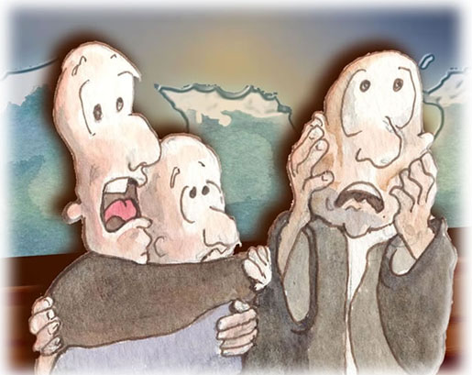
!!!Be Afraid, Be Very Afraid!!!
Notes:
What do you mean we have to judge goats this year? I don’t know anything about judging them “can eaters”. I can’t judge them!!

Slide 3
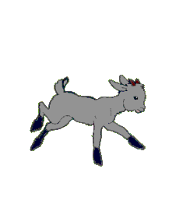
GOTCHA JUST KIDDIN’ AROUND
Notes:
Naw, just kidding around they are really simple to judge if you will take the points that are covered in this slide set and study them, No Problem.

Slide 4
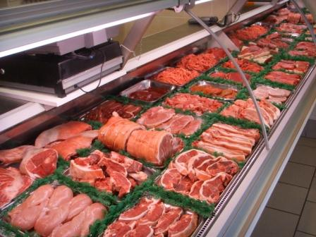
Notes:
Goats are just meat animals and should be judged like any other meat animal. While the white middle class people don’t consume chevon, they raise them for meat to sell and they are a growing part of animal agriculture in Tennessee.

Slide 5
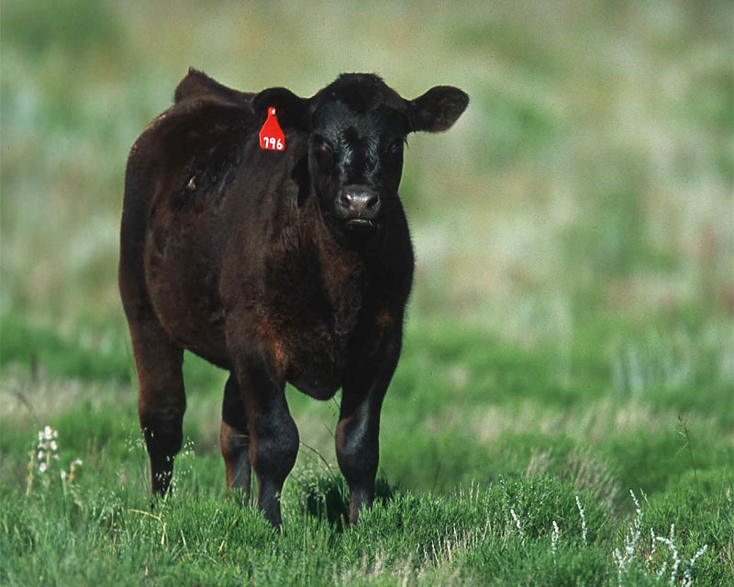
Notes:
You judge them just like cattle

Slide 6
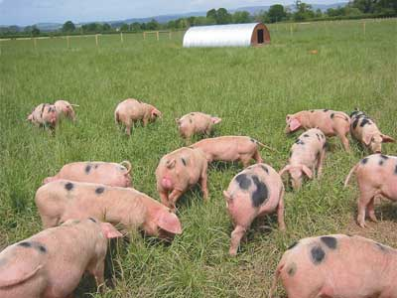
Notes:
Or swine

Slide 7
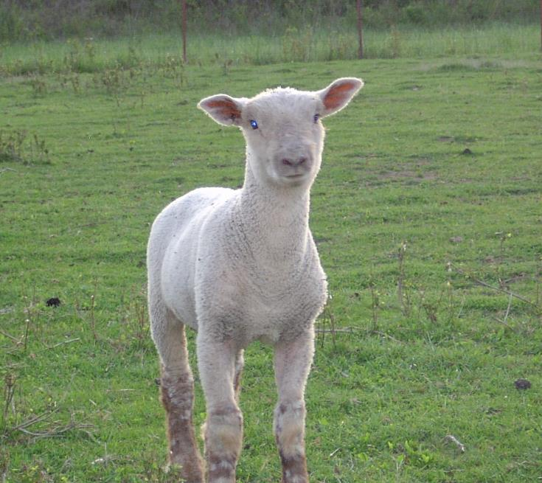
Notes:
Or sheep

Slide 8
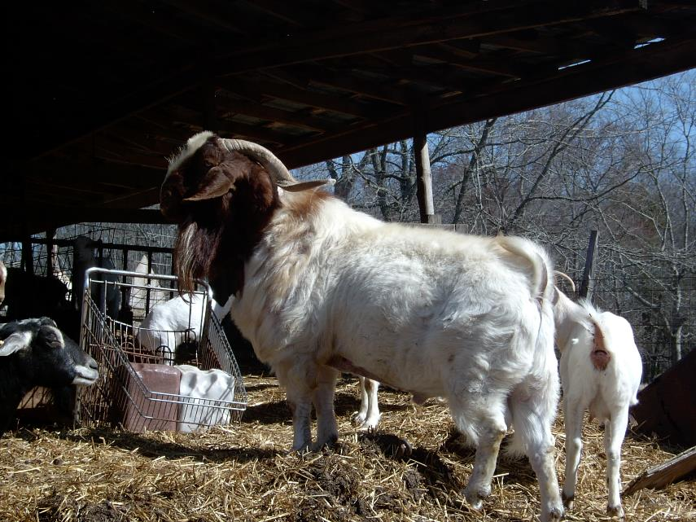
Notes:
The good ones just stand out like any other specie

Slide 9
Structural Correctness
Muscling
Size For Day of Age
Breed Character
Notes:
When judging goats, you need to place the classes in the following order of importance. First is Structural correctness. These animals need to be phenotypically correct in order to move and eat and provide a quality carcass in a reasonable length of time.
Slice 10 The next thing that you look for is the degree of muscling of the animal. Since we are raising these animals to eat, the amount of muscling is the second most important thing that we are looking for in judging. These are the two most important things that you need to consider when judging a market class.
Slide 11 When you are judging a breeding class, you still need to look at the two previous characteristics in the same order, but you then need to take size for day of age into consideration also. Faster gaining animals are better than slower ones because they reach market weight earlier.
Slide 12 If you are judging a class of registered goats and they are called registered then you must take breed character into consideration. As with any specie of registered animal, this trait is more important to breeders than to anyone else. There will be very few times that you will have a class of registered animals to judge in the Tennessee 4-H judging contests.

Slide 10
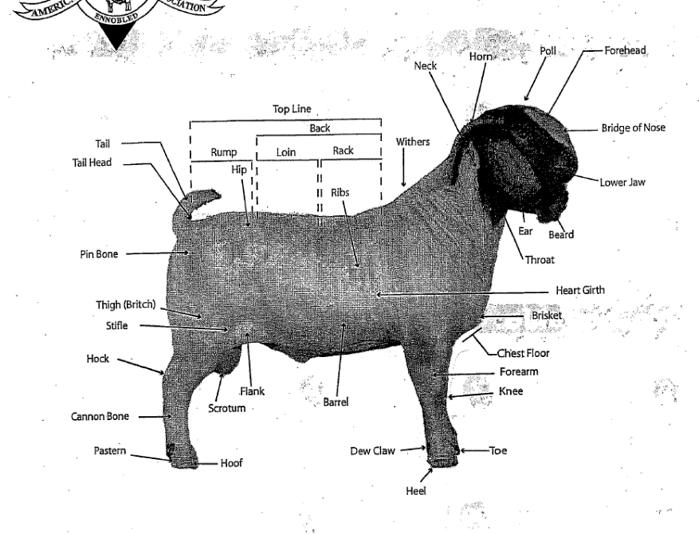
Notes:
In order to understand what to look for in judging goats you must learn the correct names of the parts of this animal. As you can tell from this slide, most of the parts are the same for the other species of livestock that you will judge.

Slide 11
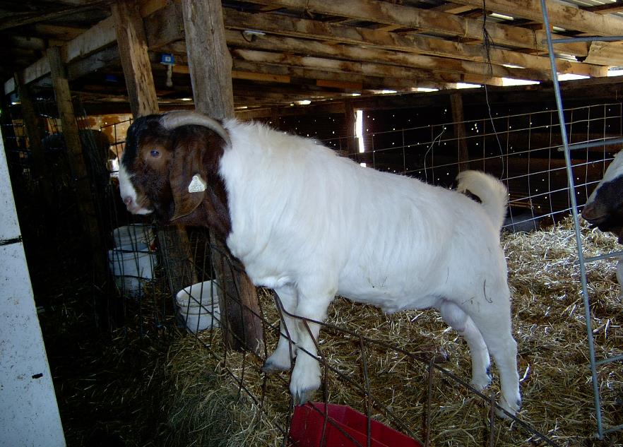
Notes:
Quality animals produce quality animals whether they are goats or cattle or sheep. Look at the quality of this breeding buck. Long sided, level out through the hip, heavy boned with a foot of adequate circumference.

Slide 12
Notes:
Guess what, this is the previous buck’s sire. See any similarity between these two bucks. Long sided, level hipped and heavy muscled. Both are excellent bucks.

Slide 13
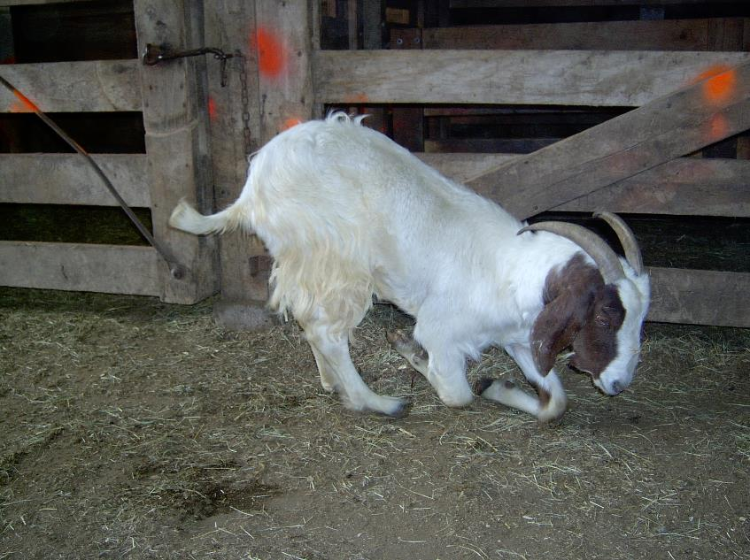
Notes:
When we are talking about structural correctness, this is an extreme case. This doe was at one time, a show animal herself. Not anymore. Pay close attention to the length of the pastern of any class of goats. Some breeds have longer pasterns and usually this is one of the things that we see when we have to cull these goats from the herd. This particular goat was over conditioned at one time and it caused her to break down in her front end.

Slide 14
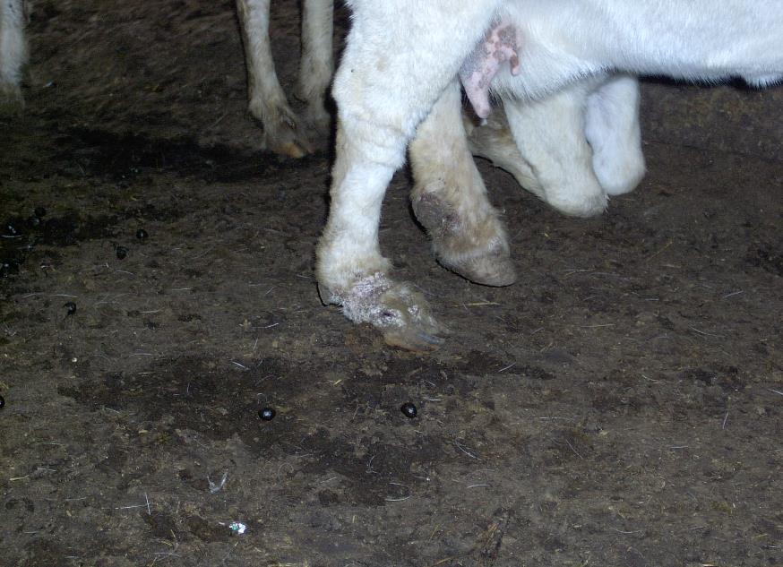
Notes:
This is a more typical example of weak pasterns in a goat. Notice how the dewclaw touches the ground just like the hoof does. This is a strong criticism in a class of breeding goats and a criticism also in a market class, but not as strong. It would carry more weight in a feeder class than in a “ready for slaughter” class.

Slide 15
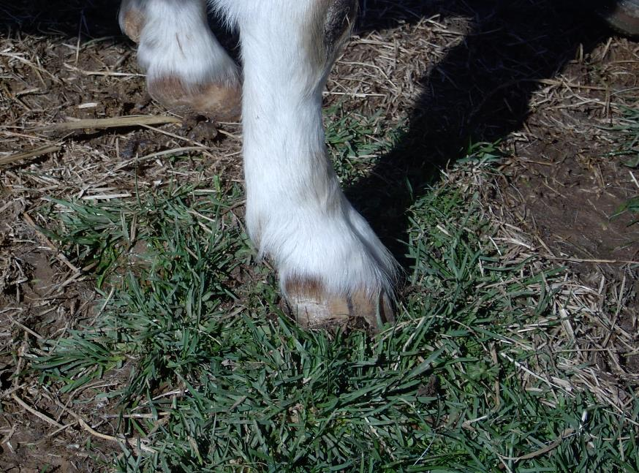
Notes:
This is a more correct pastern. Note the angle of the pastern in direct relationship to the ground.

Slide 16
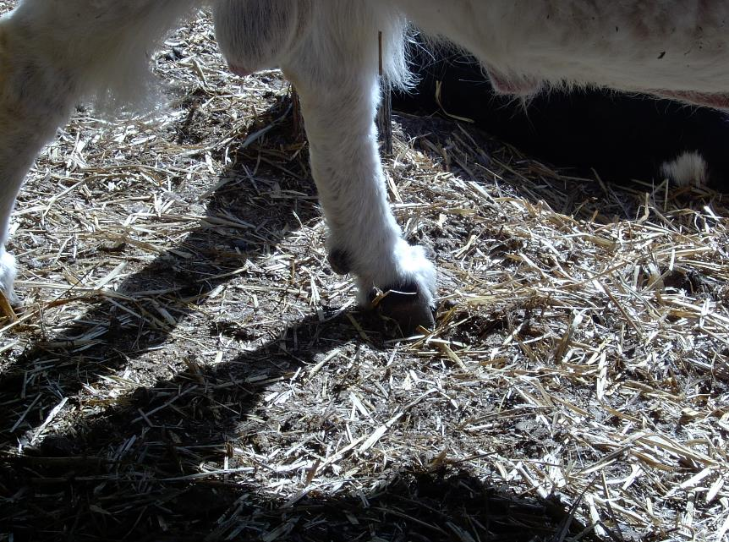
Notes:
This is an even better example of the correct angle that a pastern should have. The pastern may appear to be a little long, but it is strong and has an almost perfect angle.

Slide 17
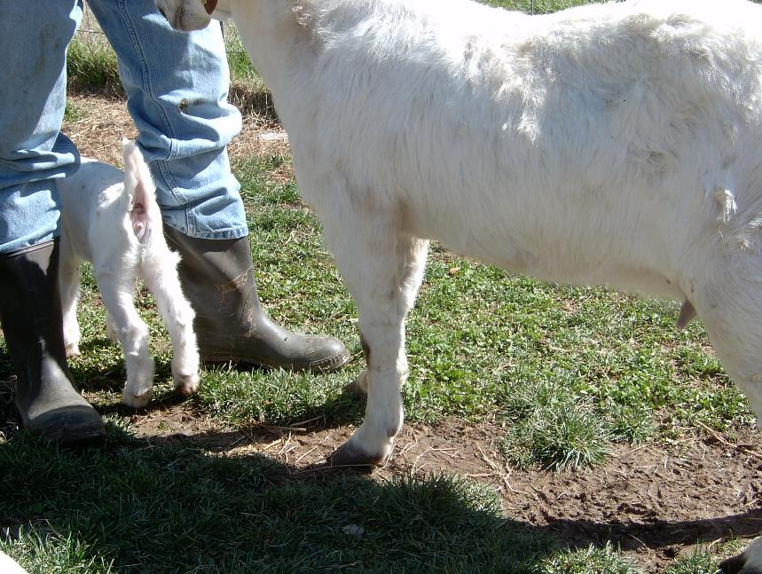
Notes:
Lets take a minute and look at the entire front leg of this doe. What is the first thing that you notice? It appears that the angle of the pastern is acceptable. The cannon bone is perpendicular to the ground and the shoulder blends into the neck and rib in a very acceptable fashion. I find no faults with this view on this goat.

Slide 18
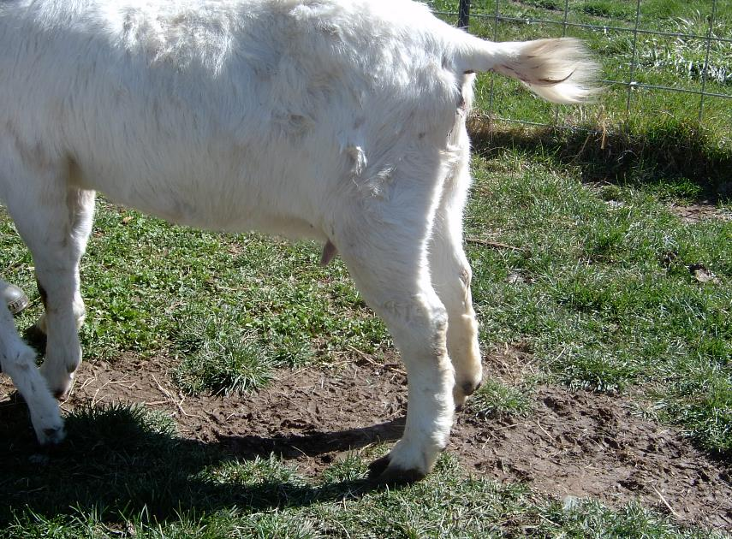
Notes:
Now let’s look at the rear legs. The first thing that I see is that the length of the pastern appears to be a little long and the goat has a sloping angle to the pastern. She is somewhat cow hocked with the hocks of both legs turned in toward each other. With this goat, the front end is better structurally that the rear legs, therefore there are major criticisms on the rear legs of this goat.

Slide 19
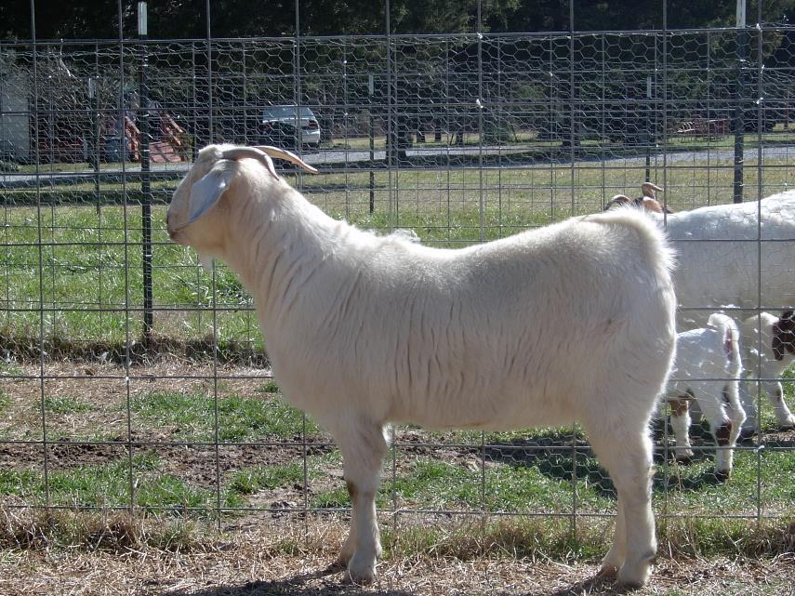
Notes:
When viewing a goat from the side, you need to look carefully at three things. The first is the levelness of the hip. Goats do not have a level dock like market lambs. There is always some slope to their hip. This doe has a very acceptable hip structure and a mental picture of this as a comparison to other goats that you see would be advantageous to student judges. The second thing that you need to observe is the length of side. This is a very long sided doe when you observe her from the shoulder to the hip. While you have this side view, you need to observe the strength of the top line of the goat. This goat has a slight break behind the withers, but not enough to merit a deduction of points at this time. Some extremely long goats are not strong enough to keep a level top line and fall apart. The final thing is to look at the blending of parts to see if the goat appears to be smooth throughout her body. This particular example is very smooth and all of her parts flow together well.

Slide 20
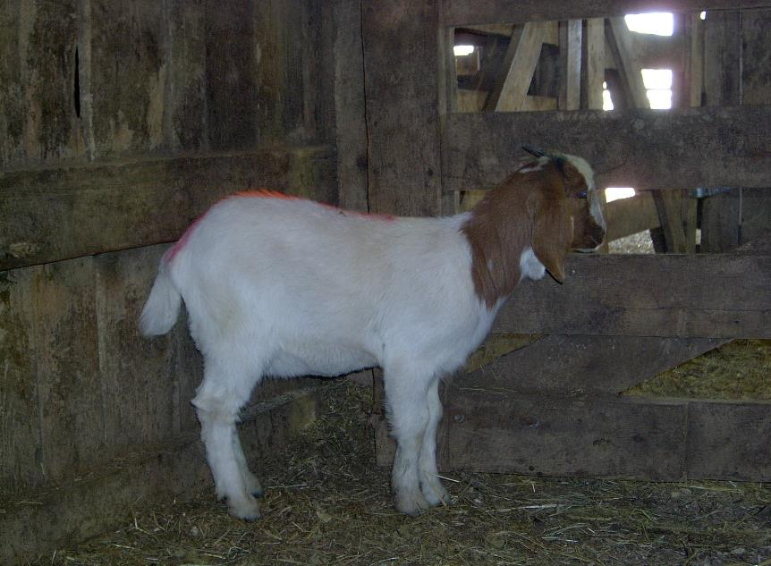
Notes:
Let’s look at this example. The first thing that you should see is that this animal has a very sloping hip, even for a goat. This needs to be a major deduction when judging this animal. She is short sided when you view her from the side. There is not much room for this doe to forage for feed and carry a set of twins in her. I will give her credit that she does appear to be balanced and her parts do flow together well and she does have a good set of feet and correct angle of her pasterns. That is about all she has going for her

Slide 21
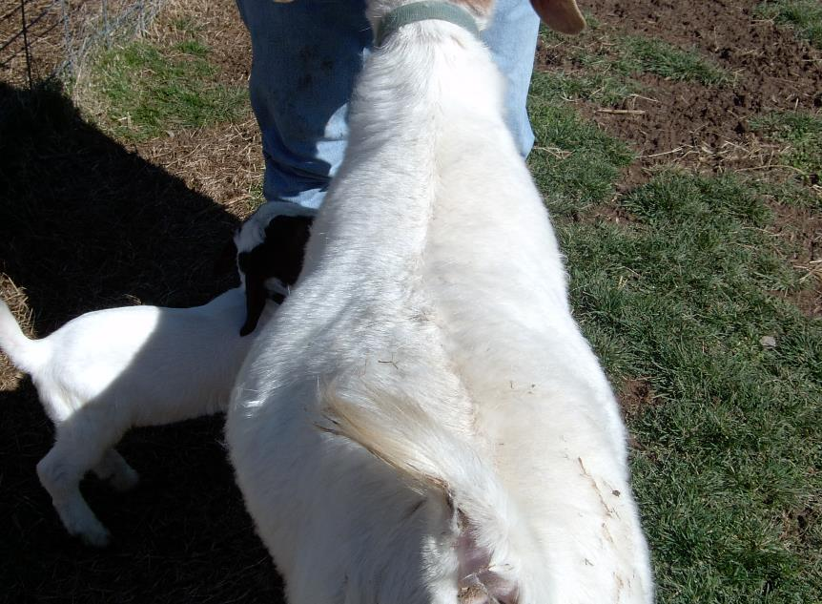
Notes:
It is often helpful to move up and look over the top of the goat. This will give the judge a way to check the natural width of the top of the goat, but also gives them a chance to observe how well the goat blends its parts together. This particular goat is an excellent example of what we are looking for in a breeding doe. What is the duty of a breeding doe? To provide an acceptable place for the egg to get fertilized and the fetus to grow and to give birth to live kids and provide adequate milk for the kids to grow and thrive. Providing milk is a major part of a doe’s responsibility. Look at the triangular shape of this doe. See how she is small in the neck area then extends back getting increasingly wider until you get to the hip area. This doe excels in the natural triangle shape that is needed in a doe for production. Old dairy producers used to talk about the dairy triangles on a dairy cow. This is one of those. The second is the triangle that you should see when viewing the doe from the side being narrow in the neck area the getting wider back to the tail area then down the rear leg then back up under the doe’s stomach into the neck again. Some registered goat judges are starting to use this terminology in their reasons.

Slide 22
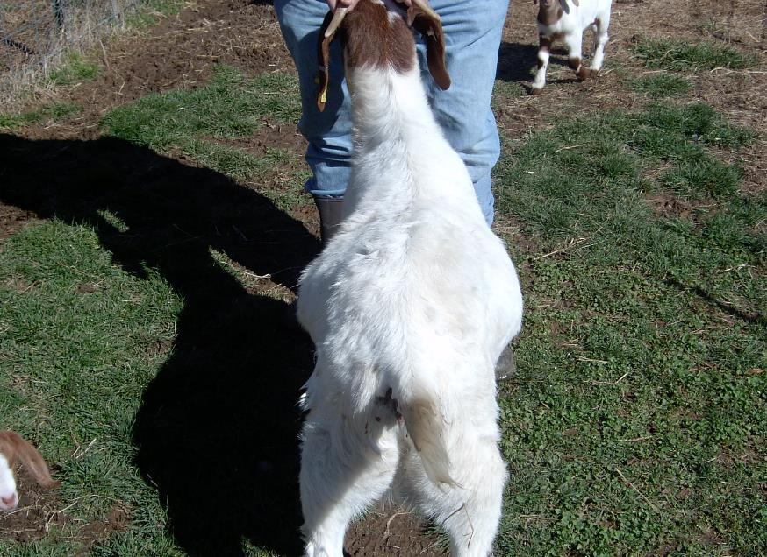
Notes:
Let’s compare this animal to the last one. Does she have the natural triangle that the last one had? No, she does not. She does not blend in well at the shoulders and is rough in the wither area. She is carrying too much fill and is much narrower through the hip area than the previous does exhibited.

Slide 23
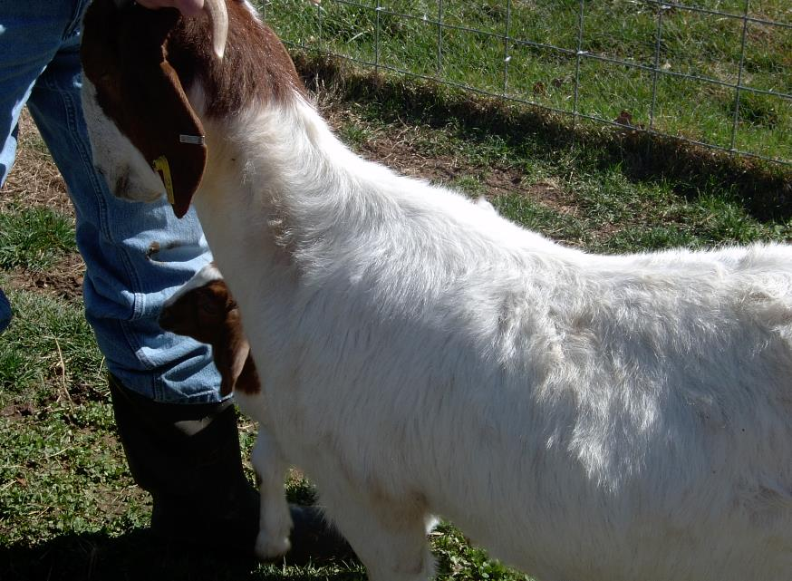
Notes:
When we look at a correct goat, the parts need to blend together in a smooth pattern. This does is very thinned necked and blends very smoothly into the withers and in the shoulder area and back in the fore rib. She is smooth going into the front part of the loin and shows no excess flesh in any of these areas.

Slide 24
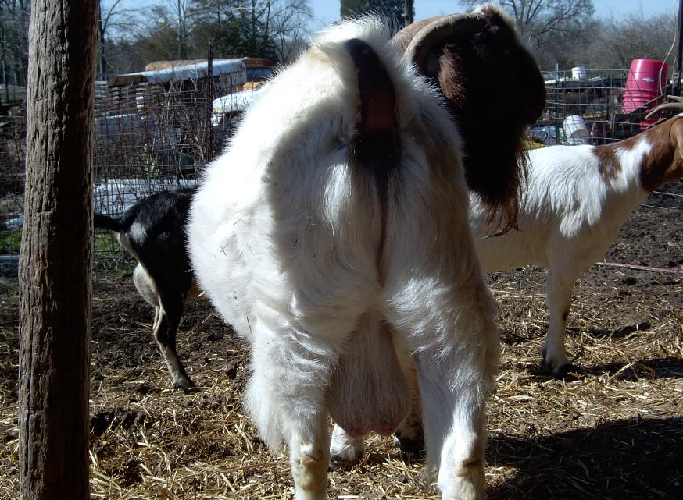
Notes:
The second criterion for judging goats is the degree of muscling that a goat has. This is an excellent example of a heavily muscled goat. Note the width that this goat has between his rear legs. Note the circumference of the thigh or let of this animal. Also, look at the width from the outside of his thigh to the outside of the one on the other side. These are very good indicators of muscling the same as in any specie of meat animal.

Slide 25
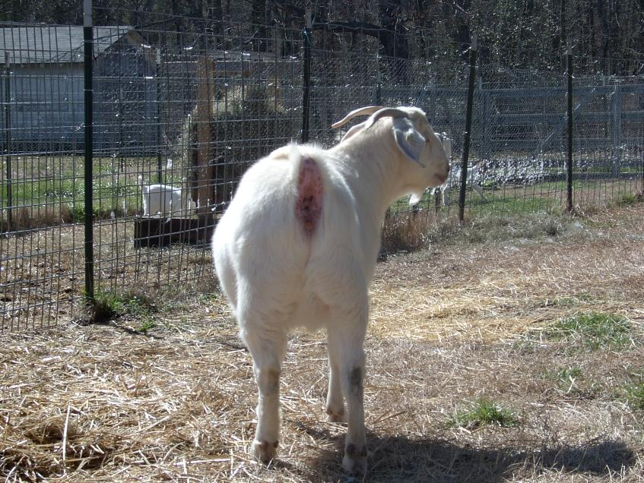
Notes:
This is another example of a heavily muscled goat. Once again, note the width that this goat exhibits in the same places as mentioned in the previous slide; between the legs, around the thigh and from outside to outside.

Slide 26
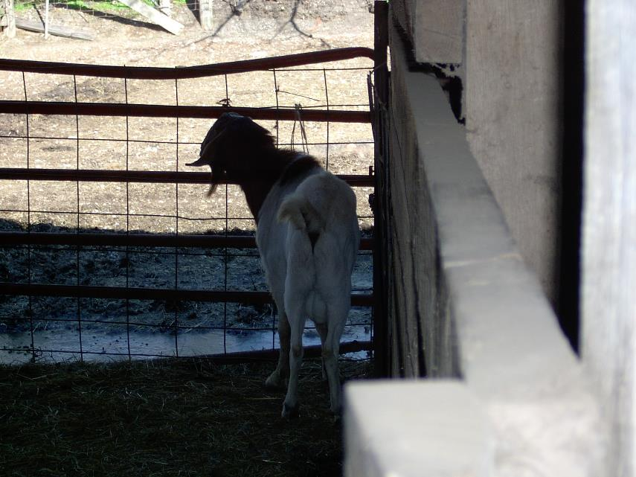
Notes:
Lets compare this goat to the ones in the previous two slides. What do you see about this one? I hope you see the short distance between the rear legs and the lack of circumference around the thigh. This is a very thin buck that lacks muscling. This is what we call a narrow based goat. Heavy criticism on this goat for the lack of muscling. Also note that the rear hocks tend to angle together. This goat has some structural problems as well.

Slide 27
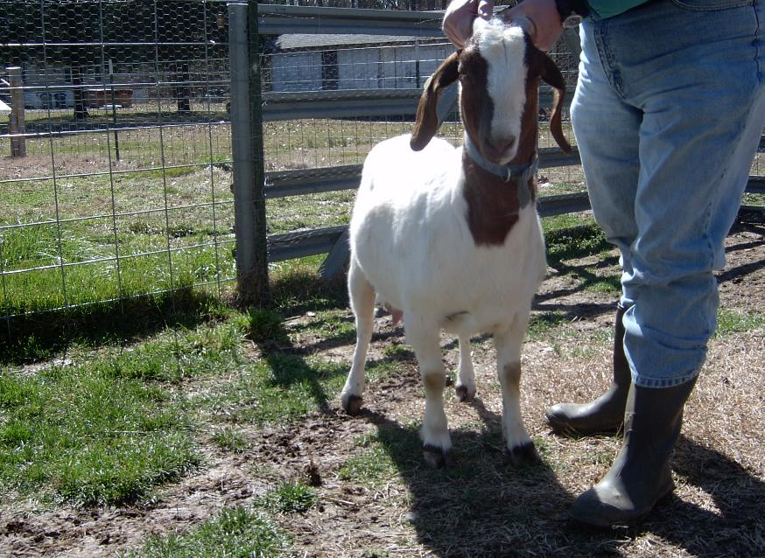
Notes:
What do you think of this goat? At first, she may appear to very heavily muscled. Is this muscle or is it fat?? In this case it is some of both. One of the best ways to correctly judge the amount of muscle that a goat has is to look at the muscle on the forearm of the goat. This is one of the best places to observe the muscle and not get confused and think that fat is muscle. In viewing this doe from the front, she is thick, maybe a little coarse fronted, but look at the bulge on muscle in the forearm. It is very visible and is of adequate in size to indicate that this is a heavy muscled goat.

Slide 28
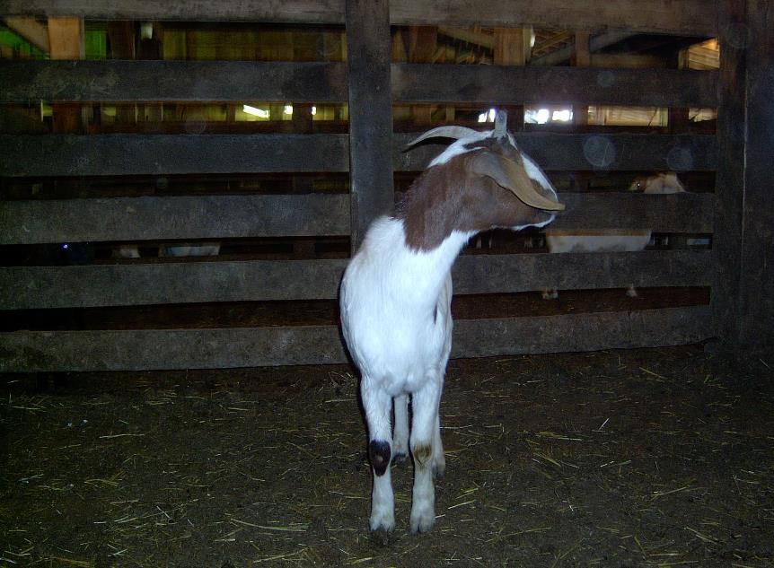
Notes:
Compare the last slide to this doe. What would you guess that the degree of muscling does this doe exhibit? If you said the she was lacking any degree of muscling, you are correct. Look at the width between the front legs. You can barely fit two fingers between her front legs. Look for the bulge of muscle in the forearm. Do you see any? There is a very small muscle on her right forearm, but there is none visible on the left forearm. This is a classic example of a “meatless wonder”. Heavy criticism in lack of muscling on this particular goat.

Slide 29
Notes:
Blank slide: Now that we have gone through the different things that you are looking for when judging goats, let’s look at some specific examples of what we have already seen and compare them to the following goats.

Slide 30
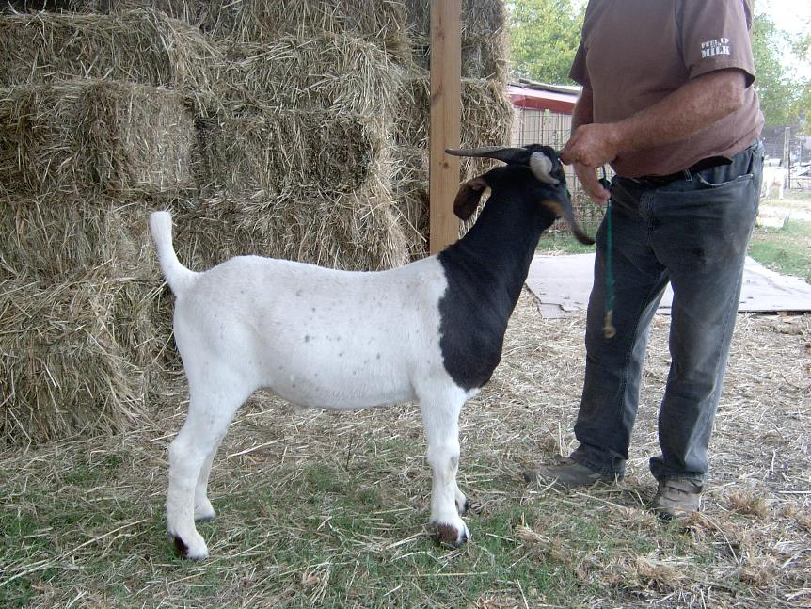
Notes:
When I look at this wether goat, the first thing I look for is structure. Note that the coloration of the pasterns makes it difficult to see them in this photo. If you look close, you can see that they are short and have the correct angle. This goat seems to have the correct set in both the front and rear legs and blends well into the shoulder. This animal is long sided and is nearly level from the withers to the hip. While this goat does have some slope in the hip area, this slope is acceptable. Look at the degree of muscle that you see from this angle. He shows excellent muscling in the front forearm and has an excellent bulge of muscle in the rear leg.

Slide 31
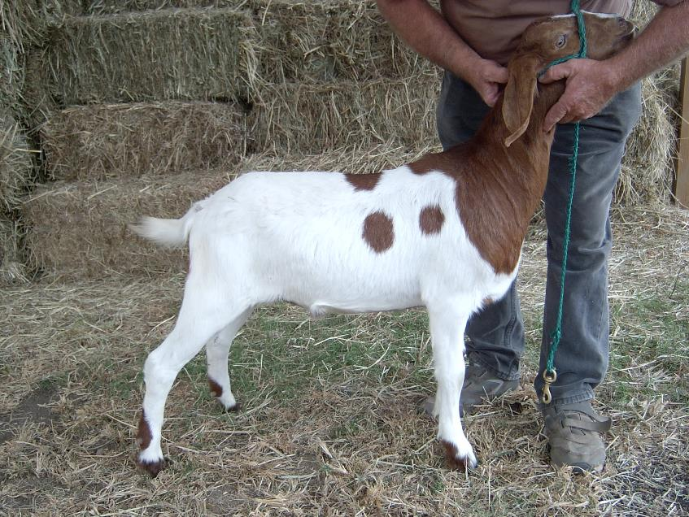
Notes:
Let’s look at this goat from the same side view. Once again, when looking at the pastern, we see that the color once again makes it difficult to see this really well. If you look closely, you can see that these pasterns appear to be a little long and the front one has a sloping angle. The front shoulder appears to be a little rough, but is acceptable. This goat is rough in the withers and is shorter sided than the previous one. While this goat has a very strong top line, it exhibits a much sharper slope in the rump area than the previous goat. While this animal exhibits some muscle in the forearm area, it is not a pronounced as the previous goat nor does it have the bulge in the rear leg either.

Slide 32
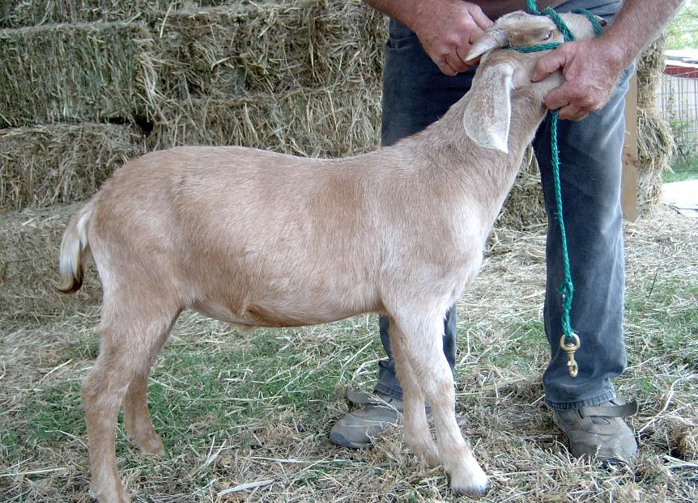
Notes:
In this final side view, we see a goat that lacks several of the things that we saw in the two previous goats. While it does appear to have a short correct angle of the pastern on the front left leg, when we look at the right front leg, it appears to me long and has too much angle also. It is very coarse in the shoulder area and does not blend in well in the neck junction. The goat has a weak top line and is short sided. It has a very sloping rump area and exhibits very little muscle whether you are looking in the forearm area or in the rear leg.

Slide 33
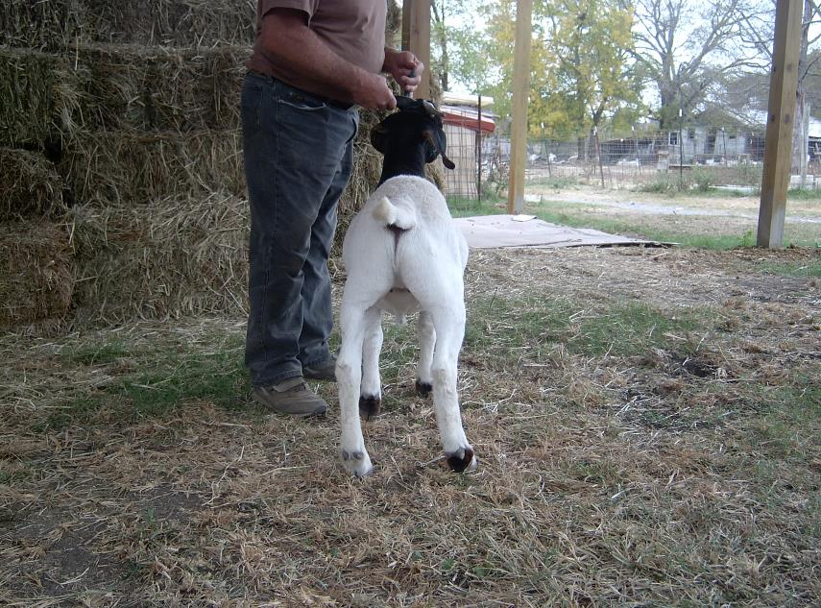
Notes:
Let’s look at these same goats from another angle. When we look at this goat from the rear, we see that this goat stands very wide behind. He exhibits a very desirable leg muscle that is very full.

Slide 34
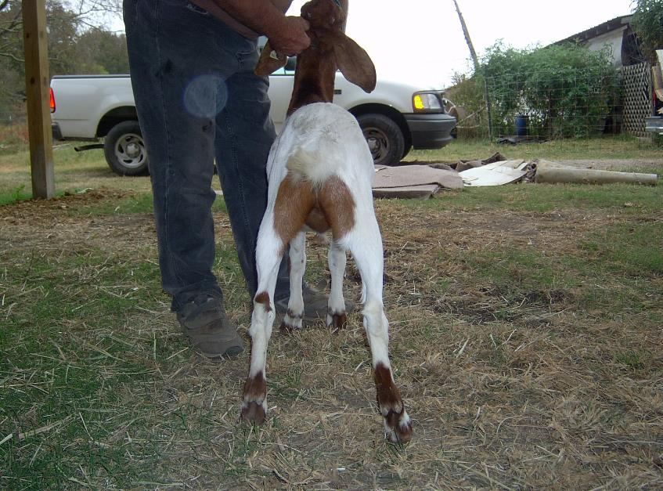
Notes:
While this goat also stands wide when we look at it from the rear, you should see that this is not a natural stance. Also, while there is some degree of muscling in the leg, we don’t see the degree that we did in the previous goat.

Slide 35
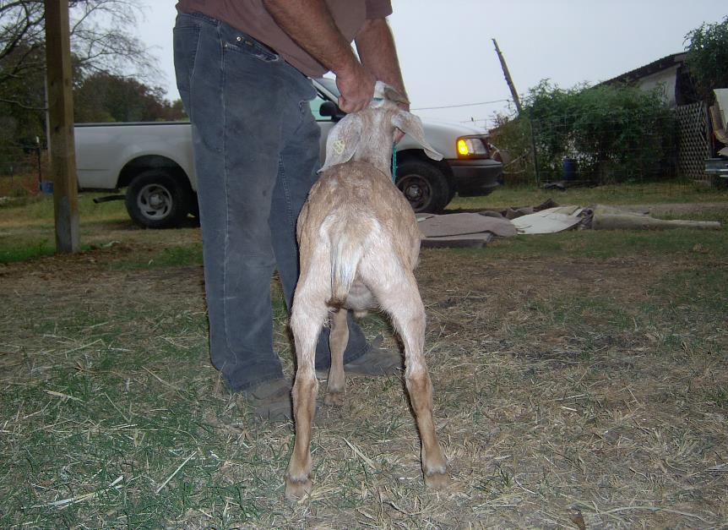
Notes:
When we look at this goat, it too has the unnatural wide stance behind. His goat does appear to have some wide in muscling at the mid thigh area, you should be able to see that above and below this area, it is sunken in and devoid of muscle in these two areas. This tells me that what we are seeing in the mid thigh area is either bone or hair.

Slide 36
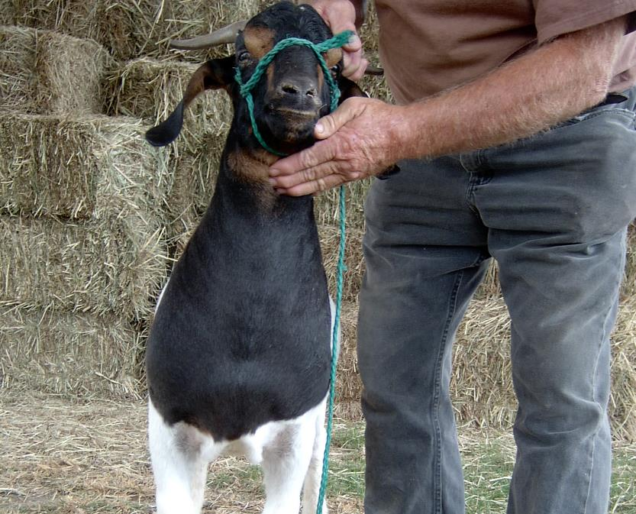
Notes:
Looking at this goat from the front, we once again see a natural thickness and width between the front legs. Note the bulge of muscle in the forearm area of this goat. The neck blends in well with the front of the shoulders.

Slide 37
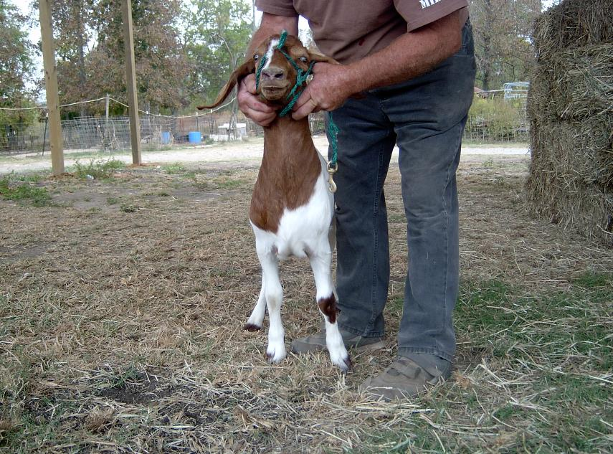
Notes:
While this picture is not as close as the previous one, you should notice the some waste between the front legs. There is not the degree of muscling that we saw in the previous goat and the front end exhibits some coarseness in the blending of the shoulders. Also note that there is some muscle expression in the forearm, but not to the degree of the previous view.

Slide 38
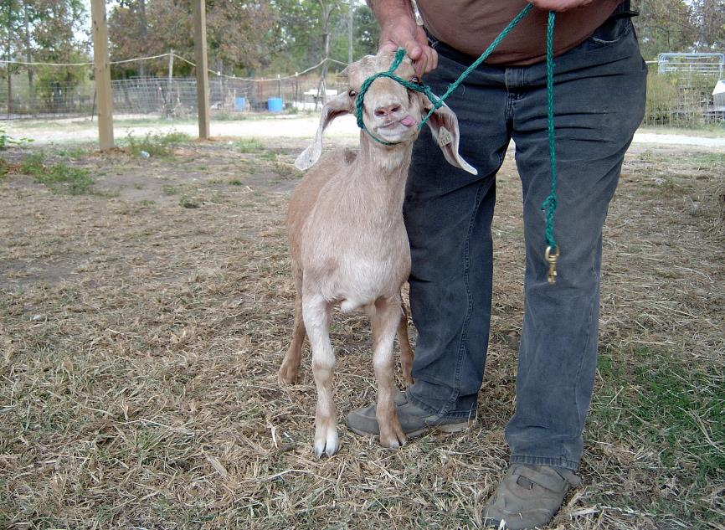
Notes:
Note the flat muscle pattern when viewing this goat from the front. There is more waste between the front legs, bulging shoulders and a narrow thin neck going into the shoulders. Also, note that the front right foot turns out in a pigeon toe shape.

Slide 39
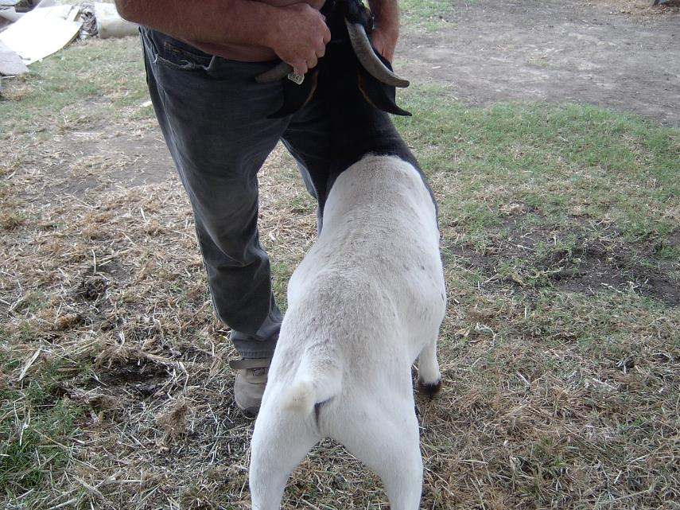
Notes:
Now, let’s take a look at each of these goats over the top. As you should be able to tell that this goat has an extremely heavily muscled top. I think that this is evident without handling a goat in this case. Also, you can see the seam between the muscles in the rear leg. This goat has a nice square top and carries this muscle out to the rump. You may also notice that you can see the slight break in the top line in this shot also.

Slide 40
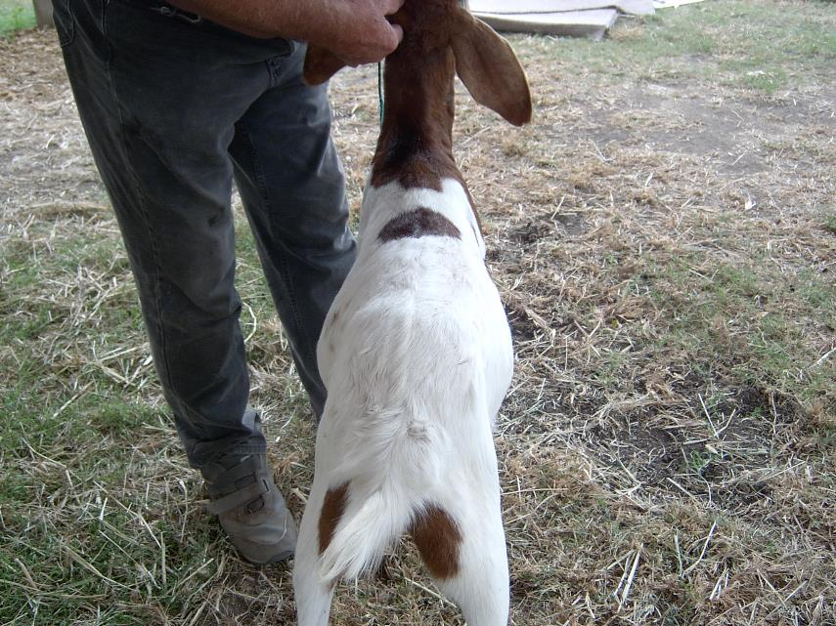
Notes:
This goat has a nice top in it also, but it lacks the thickness of the previous one. The leg appears to have some muscle, but it is not as well defined as the previous one. Also note that the neck does not blend as well into the shoulders as in the previous shot.

Slide 41
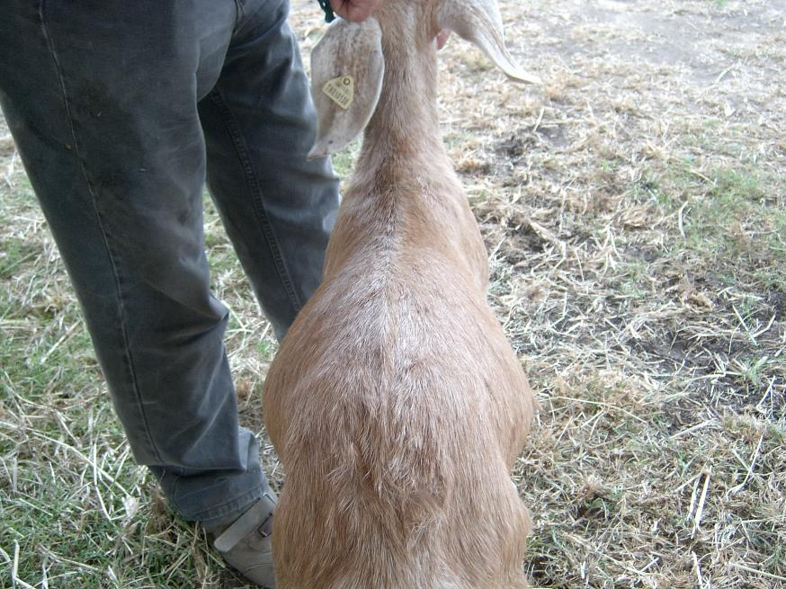
Notes:
Note the way that the top slides off to the side on this goat. It has very little prominence of muscle. It almost appears that the highest point on this goat is the backbone then it rapidly slopes away to the sides. Also, you need to note that this goat pinches in behind the withers then spread out again as we move from the front to the rear at the ribs.

Slide 42
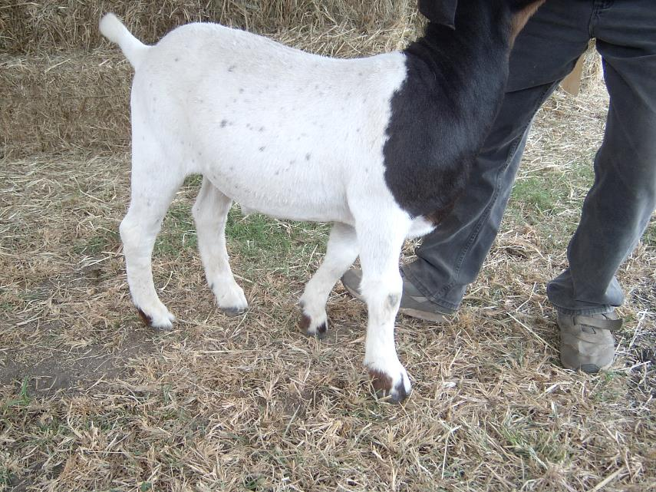
Notes:
Lets take a quick look at the muscle on the forearm of each goat. This goat has a major expression on muscle in this area. Note the bulge below the shoulder. This is a very fool proof area to judge true muscle in a goat

Slide 43
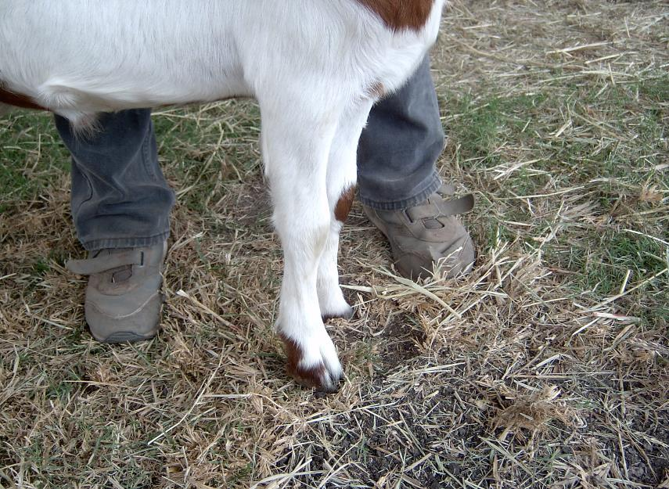
Notes:
Note that this goat has little indication of muscling in the forearm area. If you look closely, you can see a little muscle above the knee.

Slide 44
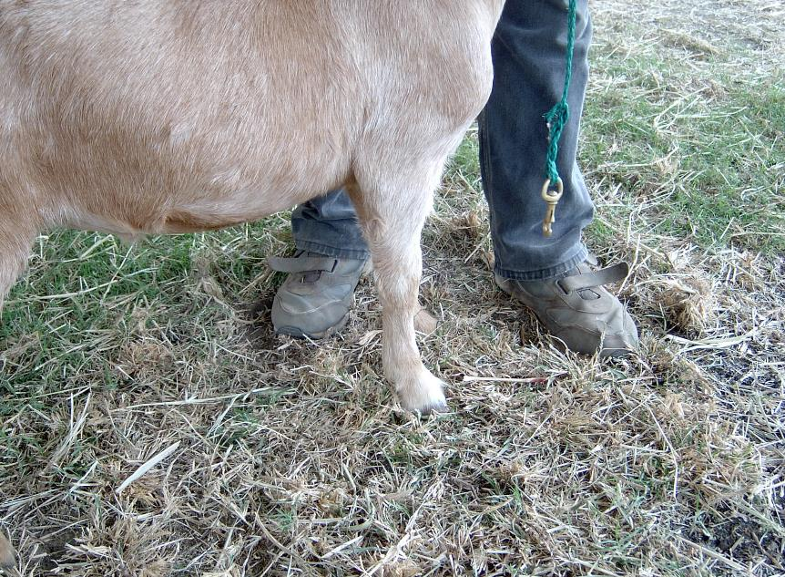
Notes:
While this is a little different angle, this goat exhibits very little muscle in the forearm. From the point of the shoulder to the knee, there is a slight arc that indicates that this goat has little muscle in this area and this means that this is a lightly muscled goat.

Slide 45
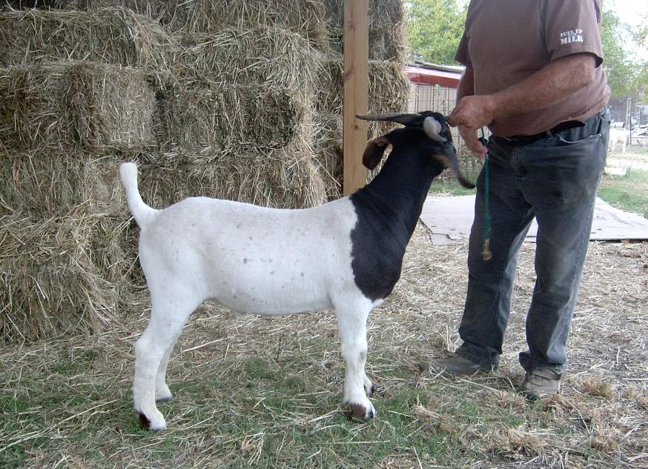
Notes:
So if this was class of goats that you were judging, this goat would be an easy top

Slide 46
Notes:
This goat would fit in the second place rather easily.

Slide 47
Notes:
And this goat would place last.

