Slide 1
Tennessee 4-H Project Portfolio Resume Activity
Pick It Apart!
Notes:
The 4-H resume is now required for both Level I and Level II. This change was made for a number of reasons including that many 9th and 10th graders are seeking after-school and summer employment, as well as the resume was identified in the survey as the “least favorite” part of the portfolio to put together. Your workgroup translated that to meaning, ”needs more practice.” Let’s look at some ideas to help you help your 4-H’er prepare his/her resume.

Slide 2
The Resume
• Use experiences, even if not paid/formal job
• Focus on life skills
• Items in Sections A, B and C will identify detail
• Action verbs
• Creativity in presentation is okay, but don’t over do it
• Write for impact
• Highlight the most important
• Spell Check!

Slide 3
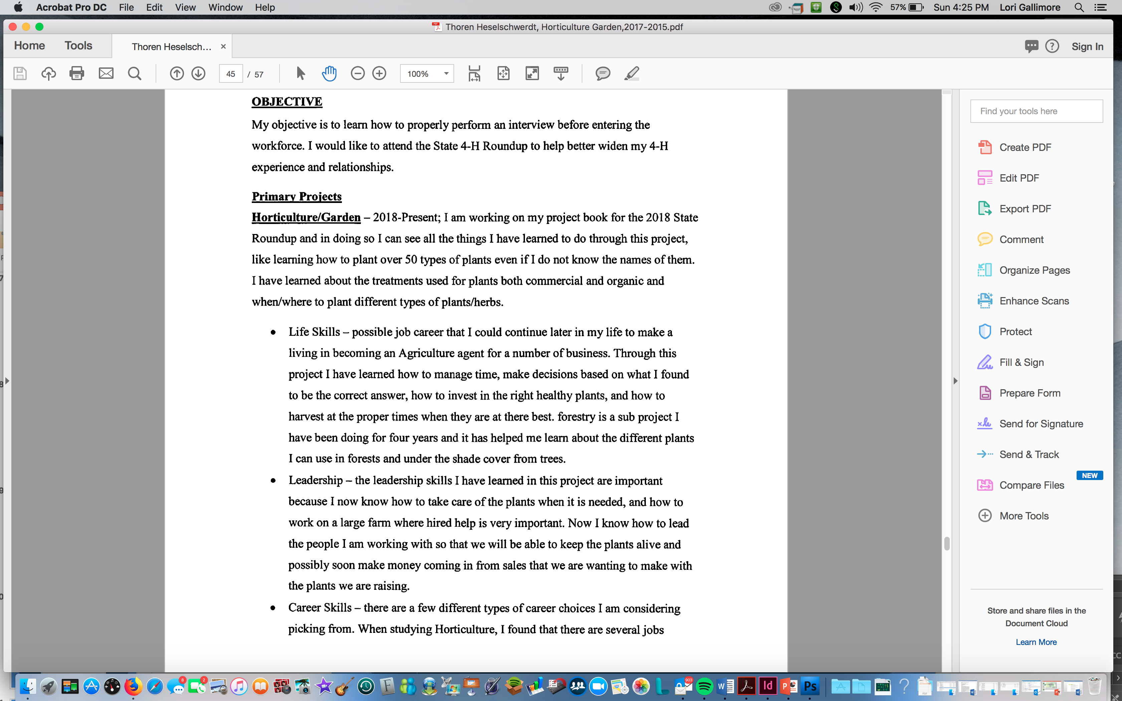
The Resume
Resume One
Notes:
The next few slides point out “issues” that are very common/typical for most portfolios.
Pick It Apart: Identify one major issue with the resume on the screen:
• Too wordy – keep in mind that on average, employers only spend about 37 seconds on a resume. Do NOT assume that judges will spend much more time. They are all scanning for impact.
• Nothing specific – throughout this resume, the 4-H’er has identified that he/she learned “how to lead the people” as a skill he/she has learned in leadership.
• Make sure that you spell check/grammar check. Throughout this resume, there are numerous incorrect sentences. Consider this one – “Possible job career that I could continue later in my life to make a living in becoming an Agriculture agent for a number of business.” WHAT?!?! This doesn’t make sense.
NOTE: This resume continues on the next slide. You may want to flip back and forth.

Slide 4
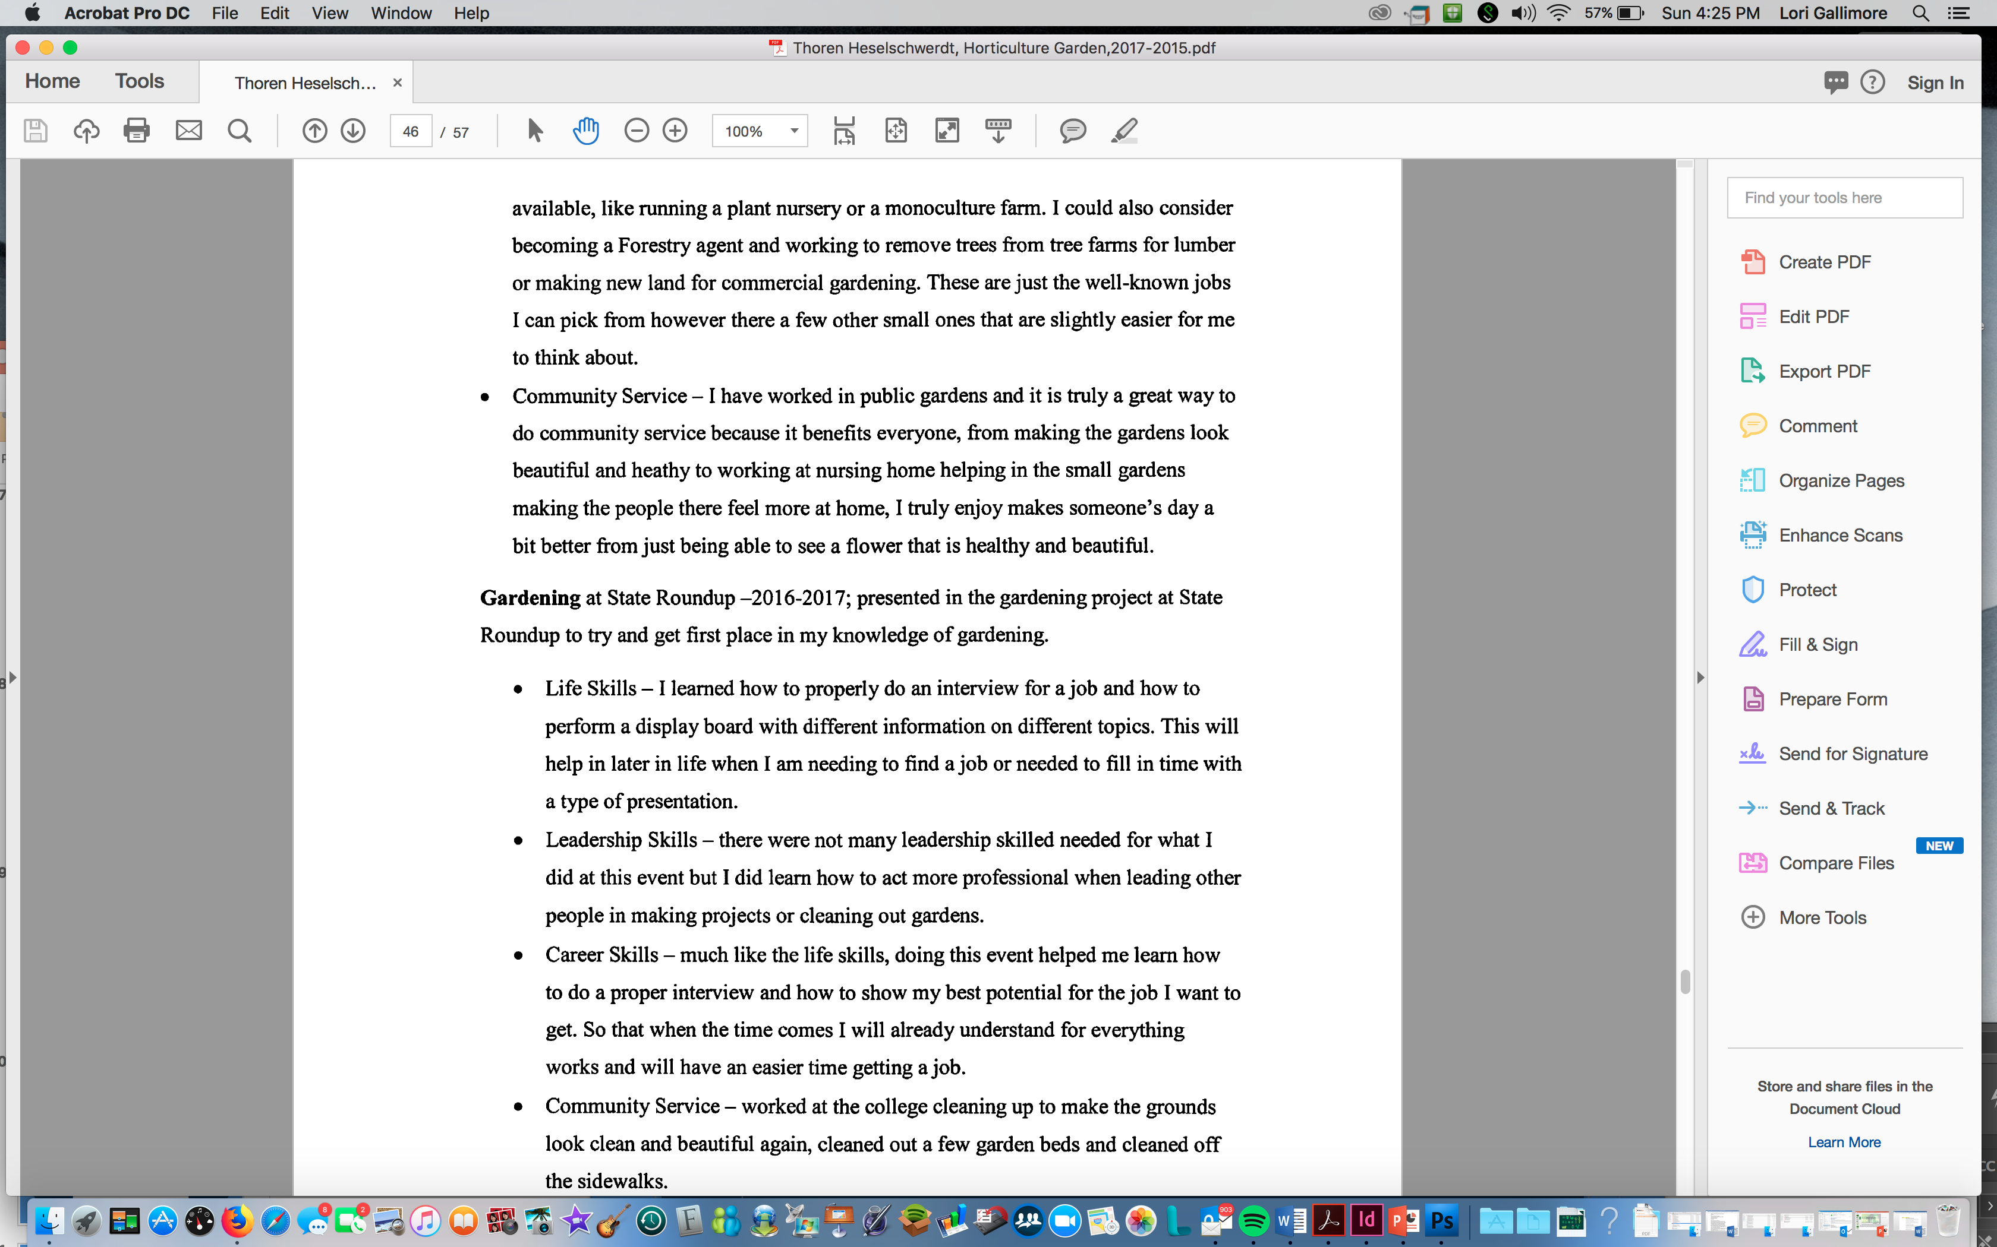
The Resume
Resume One
Notes:
Pick It Apart:

Slide 5
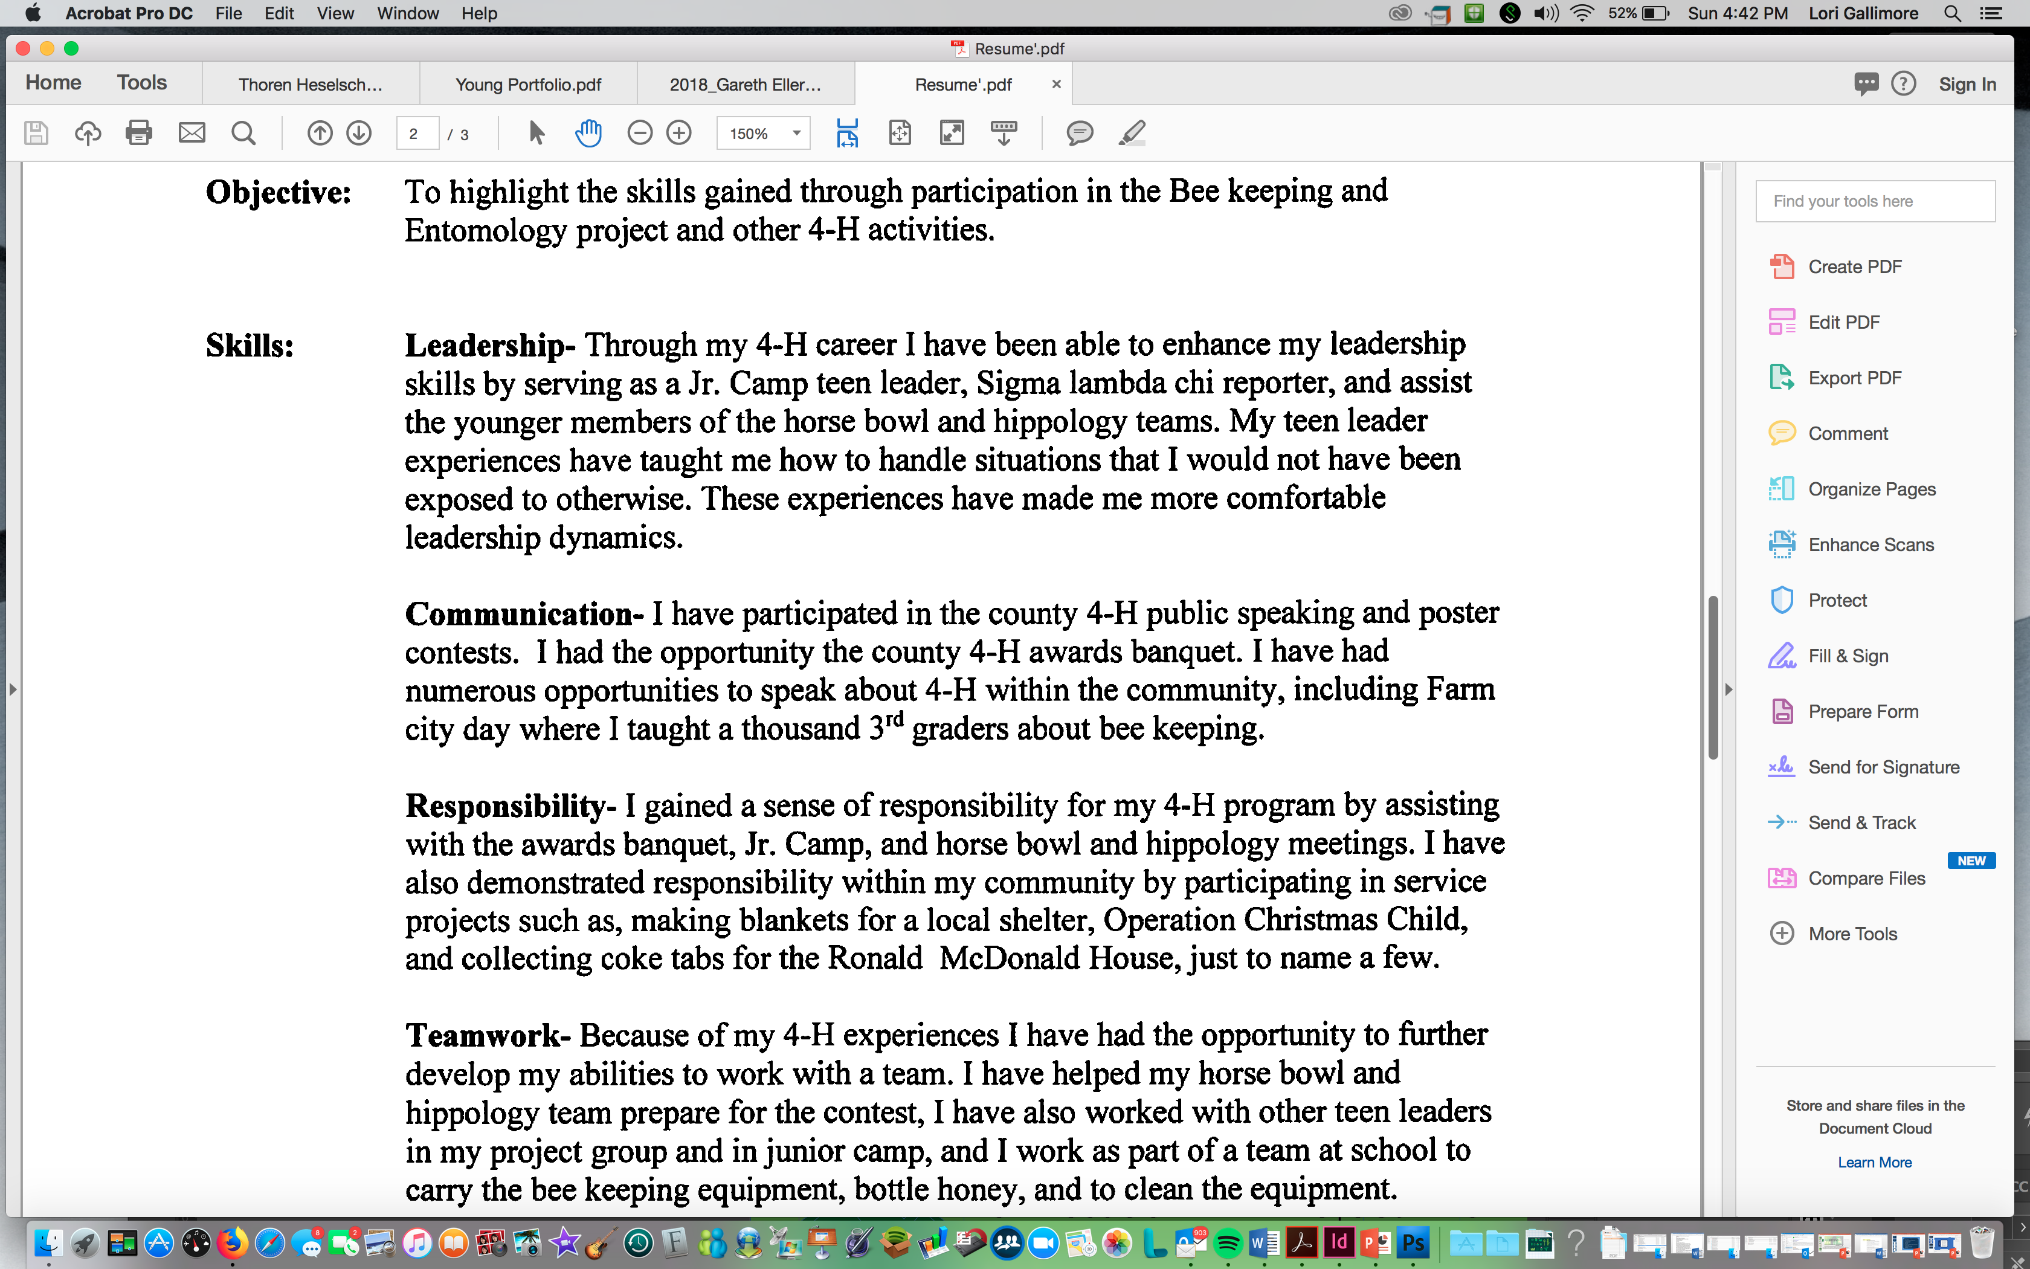
The Resume
Resume Two
Notes:
Pick It Apart: Again, this resume lacks specificity.
• Leadership – “taught me how to handle situations that I would have not been exposed to otherwise – be more specific!
• Communication – no skills identified – just restated what would appear in Section A, B, and C
• Responsibility – Gained a sense of responsibility – what does that mean?
• Teamwork – Opportunity to further develop my abilities – what kind of opportunities?

Slide 6
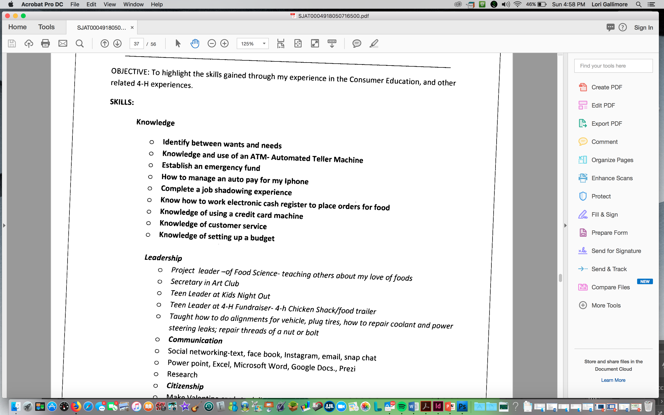
The Resume
Resume Three
Notes:
Pick It Apart:
• 4-H’er has identified hard skills and basically repeated what has been identified in other sections of the portfolio. The resume is not a repeat or highlight or summary of what is in Section A, B and/or C forms.
Let’s qualify this. It is not that what is on this resume is not important. Employers look for two sets of skills when considering a job candidate’s application or employee’s performance -- hard and soft skills. Hard skills are specific, teachable abilities that can be defined and measured, such as typing, writing, math, reading and the ability to use software programs. Soft skills, on the other hand, are less tangible and harder to quantify, such as getting along with others, managing your time, creative thinking and the ability to lead. While soft skills are less measurable (and less commonly taught), they’re just as vital for career success; some may argue they’re even more important than the hard skills While soft skills are less measurable (and less commonly taught), they’re just as vital for career success; some may argue they’re even more important than the hard skills you bring to the table.
According to PayScale’s Workforce-Skills Preparedness Report, these are the top hard and soft skills hiring managers find lacking, with some examples of how you can demonstrate these skills as a job candidate.
The three most lacking hard skills that employers are looking for include:
• Writing proficiency
• Public Speaking
• Data Analysis
The content of the portfolio itself will show potential employers the skills your 4-H’er possesses in these areas. Resumes, photo captions, Sections A, B and C forms that are clean and concise and written to show impact clearly show writing proficiency. The latter clearly demonstrates an ability to analyze data as you have recorded data and organized into meaningful statements. And public speaking?! Really?! Clearly identified in the Section A, B and C forms.
Because these pertinent hard skills are covered by the creation of the portfolio itself and because our judges can look at the details of your Section A, B and C forms to identify skills and knowledge learned, we like to focus more on soft skill highlights for the portfolio.
What about soft skills? There are five skills that employers have identified as lacking:
• Critical thinking/problem solving
• Attention to detail
• Communication
• Leadership
• Teamwork
4-H’ers currently do a great job of bringing these soft skills to the forefront, BUT the mistake that is made is when they include what they have done. It is important that activities are grouped together and relate these to a soft skill learned. Get specific. Don’t just identify “communication” – but what skills in communication did your 4-H’er specifically accomplish – conflict resolution or compromise? A gain of self-confidence? Improvement on enunciation of words? Through their teaching experiences, did they learn that it is important to include an age-appropriate interactive activity? Let’s practice.

Slide 7
What the 4-H’er Did:
• As president of my Honor Club, I worked with the members to identify a community service project to help with literacy
What Soft-Skills the 4-H’er Learned:
• Decision-Making • Brainstorming • Compromise
How to Write This on a Resume:
• Through my leadership positions with (combine with other leadership positions and insert # here) groups, I have learned decision-making, brainstorming and compromising skills.
Notes:
Explain the activity:
• An activity that a 4-H member did will appear on the screen
• Group members should shout out what specific soft skills the 4-H’er may have learned from this activity
Let’s work through this one together.

Slide 8
What the 4-H’er Did:
• I assisted an interior decorator with seven (7) home decorating projects where I learned how to place furniture and draw floorplans using CAD.
What Soft-Skills the 4-H’er Learned:
How to Write This on a Resume:
Notes:
Your turn! This 4-H’er did an internship with an interior decorating. She learned how to draw floor plans, furniture placement and how to conduct an initial client meeting. Even though your knowledge and understanding of interior design may be limited, think about what specific soft skills would be necessary for an interior decorator to be successful when interacting with clients. What soft skills might a 4-H’er learned by doing an internship with an interior decorator?
You are looking for recommendations such as listening skills, time management, project management and persuasion. After the group brainstorms, have them create a summary sentence that could be used on a resume.

Slide 9
What the 4-H’er Did:
• I worked on my families’ dairy farm where I was responsible for milking a herd of 60 dairy cows twice a day. I was also responsible for water, feed, and other basic animal care needs.
What Soft-Skills the 4-H’er Learned:
How to Write This on a Resume:
Notes:
Your turn again!

Slide 10
What the 4-H’er Did:
• I volunteered to use my photography skills to take “homecoming” photos for a local nursing home. This was in addition to volunteering to take Easter pictures during the egg hunt at church and family photos at our annual family reunion.
What Soft-Skills the 4-H’er Learned:
How to Write this on a Resume:
Notes:
Your turn again!

Slide 11
Tennessee 4-H Project Portfolio Resume Activity
Pick It Apart!

