Slide 1
RANK THESE!
A 4-H Project Portfolio
Tennessee 4-H Project Portfolio
Photo Section Activity

Slide 2
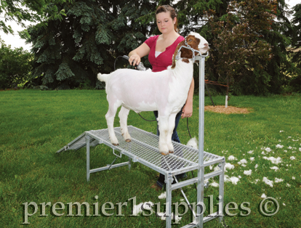
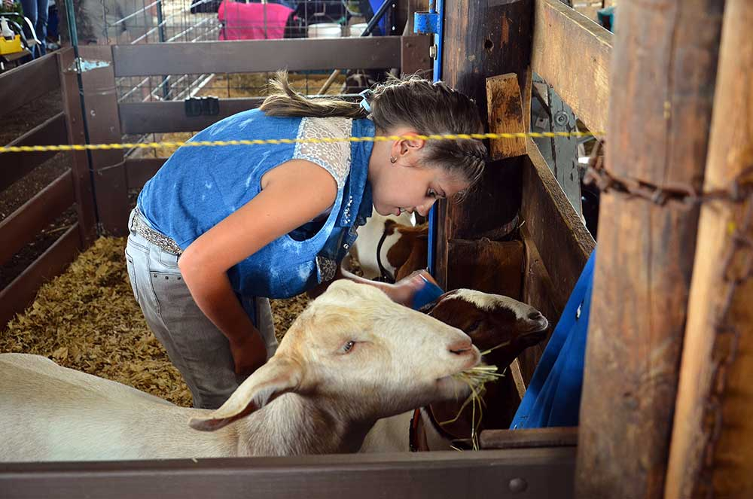
A
B
C
Notes:
Goat
Ideal order should be B, C, A – Some people may rank C first – I did not because I know that she is doing something … just not sure what. I know exactly what she is doing in Photo B. Make the point that this is how the judges think – there is alot of subjectivity when looking at photos☺.

Slide 3
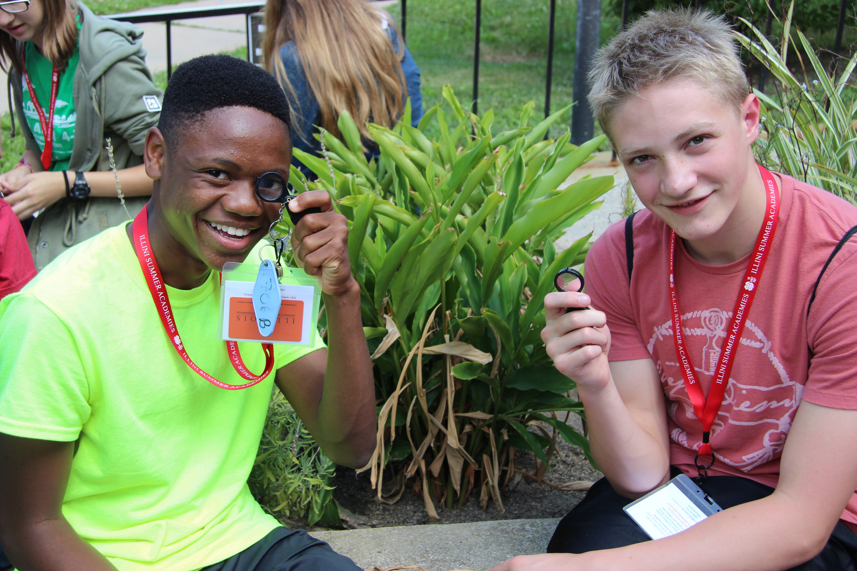
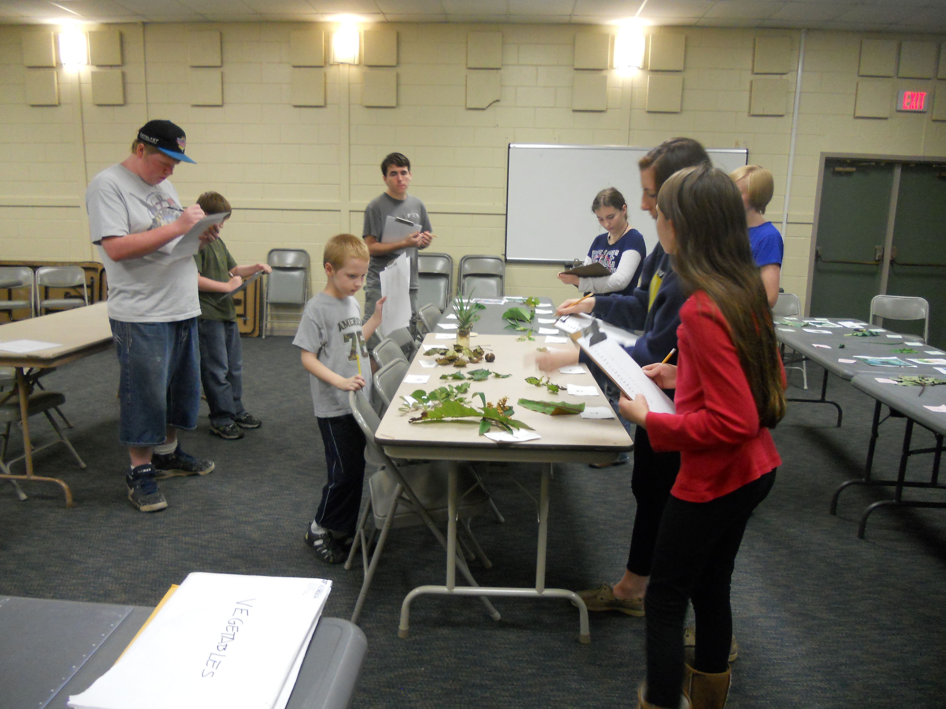
A
B
C
Notes:
Plant Science –
Ideal Rank – C,B, A – A is obviously last. B and C are both action-oriented. However, I ranked C above B because they are actually “judging” in C. In B they are learning, and not that that is not an important activity – but in C the youth is actively doing something.

Slide 4
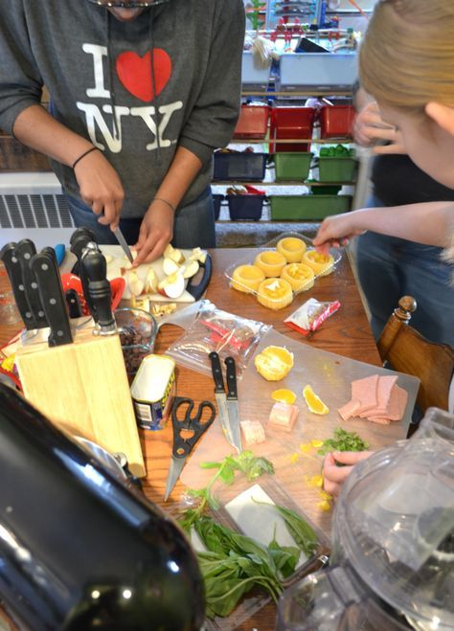
A
B
C
Notes:
Nutrition, Health and Fitness
Ideal Rank – C, A, B – A is an action-oriented photo … but I can’t see their face!

Slide 5
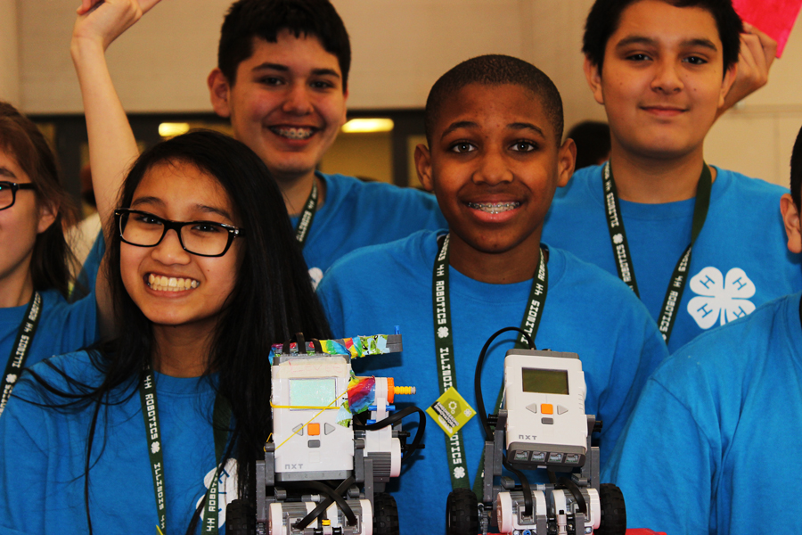
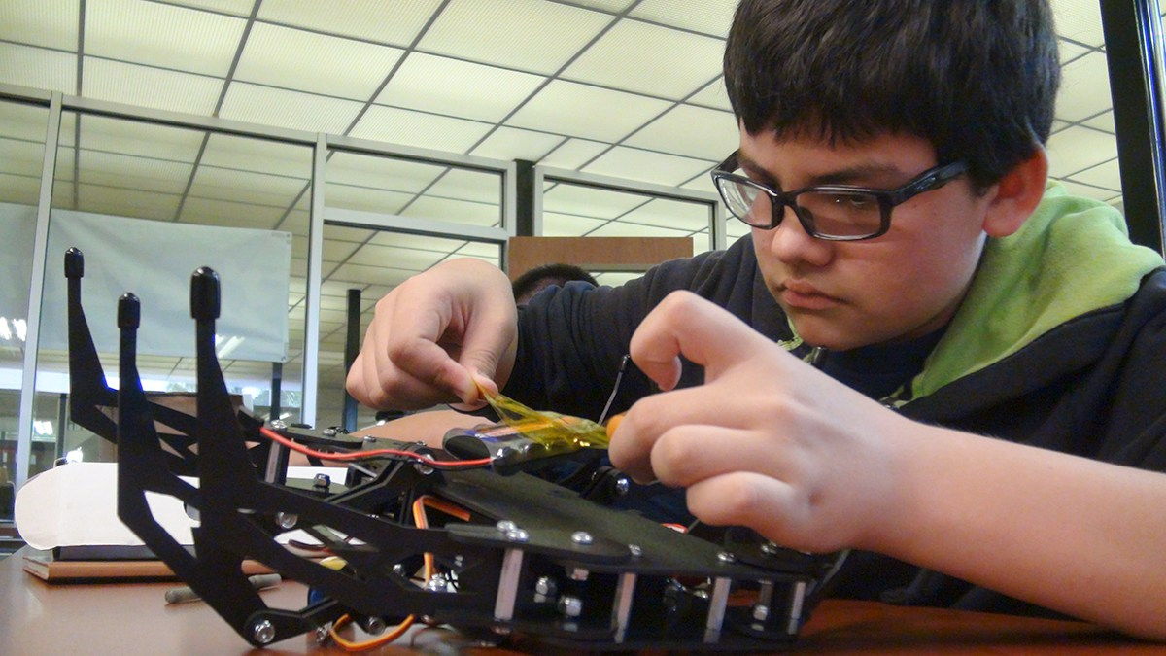
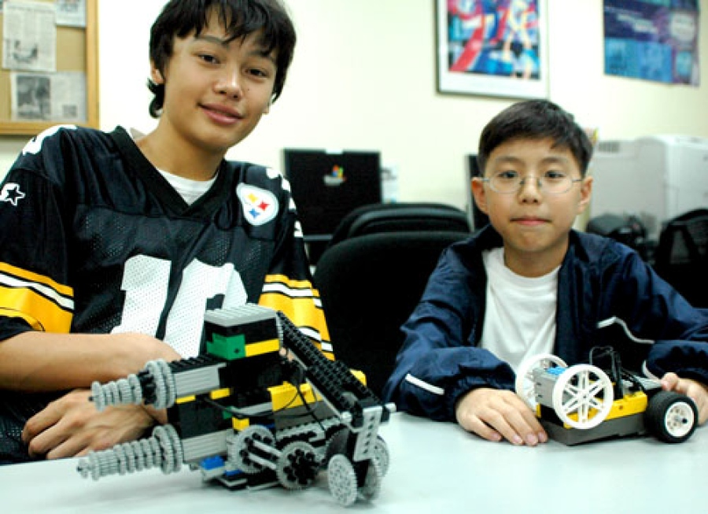
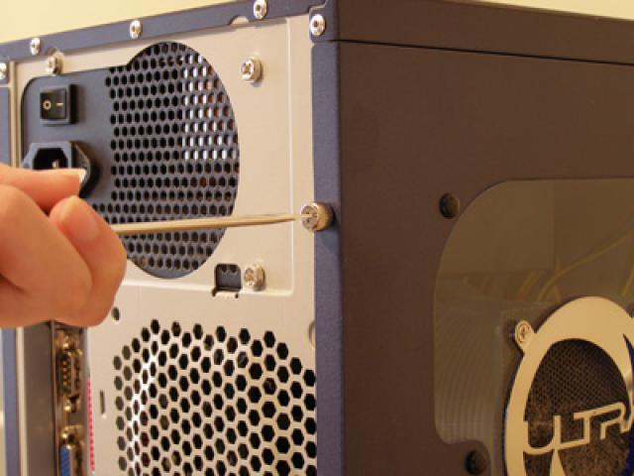
A
B
C
Notes:
Computers and Technology
Ideal Rank – C, B, A – B – they are doing something … but not sure what; Action is clearly captured in C

Slide 6
A
B
C
Notes:
Engineering and Safety Science
None of these photos are really great … but if they have to be ranked it’s either C, B, A or B, C, A – B and C are a wash – there is more activity in C ... But I can’t see the youth’s face; B .. You can see their face and their project, but there is no action.

Slide 7
RANK THESE!
A 4-H Project Portfolio
Tennessee 4-H Project Portfolio
Photo Section Activity

