Slide 1
Notes:
• Ensure that each participant has a blank Section C form that they can use.
• On the follow slides is a list of activities that may or may not belong in Section C. Your job is to determine if (1) they belong in Section C; and (2) if they do belong, where do they go? If they belong, you are to write the statement in the correct spot on the Section C form.
• ALSO note, the main project for this 4-H’er is Veterinary Science.
Ready? Here we go!

Slide 2
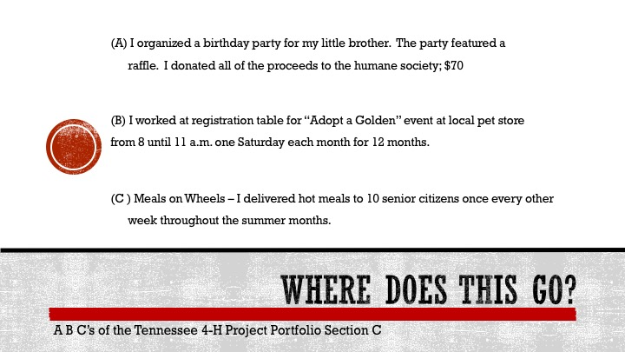
Notes:
A = 4-H Project Citizenship or Friends and Family
B = 4-H Project Citizenship or Community
C = Community
NOTE: This is what LORI sees when she looks at this book. There are other ways of looking at it and others might decide that “A”, for example, fits best in the Community section because the money goes to the Humane Society. This is the point. Each judge will look at it differently. Things are not black and white.

Slide 3
Notes:
D = 4-H Project Citizenship or Community
E = Community
F = Global or Community

Slide 4
Notes:
G = Global
H = Global
I – Community or Friends and Family

Slide 5
Notes:
J = Government
K = Does not Belong -- would go in Section A: Size and Scope
L = Government

Slide 6
Notes:
M = Does not belong; Would go in Section A: Presentations and Exhibits
N = 4-H Project Citizenship or Community
O = Global

Slide 7
Notes:
P = 4-H Project Citizenship
Q = Community or Government
R = 4-H Project Citizenship or Community

Slide 8
Notes:
S = Does not belong; Goes with Section A
T = Government
U = Community

Slide 9
Notes:
V = Friends and Family
W = 4-H Project Citizenship or Community
X = Community

Slide 10
Notes:
Y = Government
Z = 4-H Project Citizenship or Community
NOTE: Please point out just how many activities can fit into more than one category!

Slide 11
Notes:
Be cautious when “copying and pasting” from one year to the next
• It’s true that many 4-H’ers participate in the same activities year-after-year
• Help them to find new and more challenging opportunities at these repetitive events/activities
• Judges are looking for growth in knowledge and skills
Please note that Part A of Section C has to do with citizenship within the 4-H’ers main project
• This is the one area that judges complain about most – the 4-H’ers have listed just general Citizenship project activities, but they have not focused on citizenship within the 4-H’ers main project – citizenship within Performing Arts and Recreation or citizenship within Sheep or Computers and Technology
• Global section is weakest area
• Work with your 4-H’ers to come up with specific activities that would fit
• Honor Club activity?
• Eating at a Mexican restaurant, Taking a World History class – qualify, but are weak
• Encourage 4-H’er to host a Cinco de Mayo fiesta at an Honor Club meeting and have them present a short program on the history of the celebration
• Could become a leadership activity if the 4-H’er gives a demonstration on how to make guacamole
• Use World History Class as a launch for education for senior high 4-H programs, like Honor Club
• Clothing and Textiles – encourage 4-H’er to make an exhibit on clothing worn in various centuries throughout history
• Performing Arts and Recreation – presentation on history of fire arms, playwrights, classical music
• Nutrition, Health and Fitness – types of foods eaten throughout the history of the world; evoluation of table manners

