Slide 1
2023-2024 Tennessee 4-H Healthy Living Ambassadors Orientation

Slide 2
Orientation Agenda
Introductions
Program Overview
Need for Healthy Living Programs
Overview of Healthy Living/DEI
Healthy Living Ambassador Program
Healthy Living Ambassador Qualifications and Expectations
Benefits of Healthy Living Ambassador Program
Questions
Cooking Demo

Slide 3
Hosts
Erin Ortiz, MS, RDN, LDN
Extension Specialist-Healthy Living
eortiz7@utk.edu
865-974-2128

Slide 4
Hosts
Janiece Pigg, MS
DEI Extension Assistant
jpigg7@utk.edu
865-974-2128

Slide 5
HLA Introductions
My name is ______ and I would take _____ to the moon
Notes:
Group Activity

Slide 6
Program Overview
A partnership with United Healthcare was developed in 2012.
United Healthcare provided Xbox 360 Kinect for all 95 counties
Xbox, projector, speakers, games
May still be available for your use.
Events, 4-H Club Meetings, Health Fairs, etc..

Slide 7
Need for Healthy Living Programming
20% of children in Tennessee are obese
33% of adults in Tennessee are obese
78% of students do not meets daily physical activity guidelines
21% of Tennesseans live in food deserts
19.7% of youths live in poverty in Tennessee
Notes:
https://www.tn.gov/content/dam/tn/tacir/commission-meetings/2022september/2022Sept_Tab4ChildhoodObesity_Draft.pdf
Sequatchie County had the highest prevalence of overweight or obese students (54.1%) while Montgomery County had the lowest (29.8%)

Slide 8
Need for Healthy Living Programming
39.9 % of students in Tennessee reported drinking underage
20.2% of students in Tennessee reported using marijuana
8.9% of students in Tennessee reported using prescription drugs
34.9% of students in Tennessee reported using tobacco products
Notes:
https://www.tn.gov/content/dam/tn/mentalhealth/documents/2018-2019_TN_Together_Report.pdf
https://www.tn.gov/content/dam/tn/mentalhealth/documents/2018-2019_TN_Together_Onepagers.pdf

Slide 9
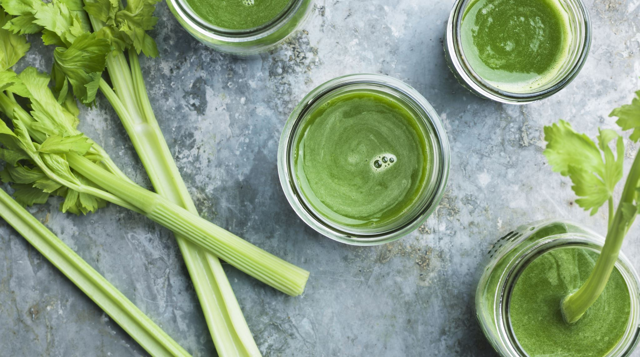
What does Healthy Living Mean to You?
Notes:
Pause for questions: talk in groups at table and produce 2-3 ideas

Slide 10
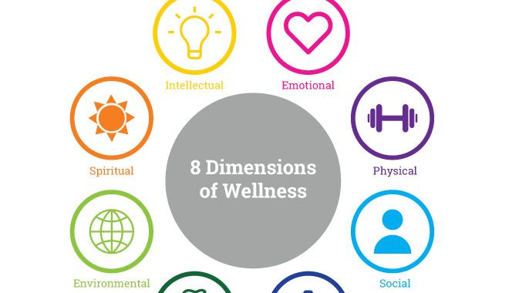
Overview of Healthy Living
Notes:
https://myusf.usfca.edu/hps/wellness-matters
https://www.tn.gov/behavioral-health/children-youth-young-adults-families.html

Slide 11
Seven Dimensions of Wellness
Psychological
Physical
Financial
Environmental
Intellectual
Spiritual
Social
Notes:
Eighth Dimension is vocational wellness, job satisfaction

Slide 12
Psychological Wellness
Focus on Mental Health
State of well-being where individuals can cope with normal stresses of life.
What are some examples of stressors?
Teaching and Activity Ideas:
Ideas on handling stress
Meditation/breathing exercises
Journaling
Ways to identify emotions
Notes:
988 and Mental Health Hotline

Slide 13
Physical Wellness
Body’s overall condition and absence of disease
Making choices that avoid illness and injury
Nutrition
Fitness
Sleep
Teaching and Activity Ideas:
MyPlate
Healthy Drinks
Simple Exercises
Sleep Lesson
How do you practice physical wellness?

Slide 14
Financial Wellness
Having control over your finances in the present and future
Making financial goals
What was your last purchase?
What it a need or want?
Teaching and Activity Ideas:
Making a budget
How to set-up a savings/checking account
Discuss needs vs. wants

Slide 15
Environmental Wellness
Personal health depends on the health of the planet
Making our world cleaner and safer place.
Teaching and Activity Ideas:
How to reduce waste.
Recycling
Safe ways to clean at home
How can you reduce waste at home?

Slide 16
Intellectual Wellness
Keeping an active mind.
Never stop learning
Finding new challenges and experiences
Teaching and Activity Ideas:
Puzzles
Brain Games
Learning style quiz
When was the last time you tried something new?

Slide 17
Spiritual Wellness
Having a set of beliefs, principles, ethics and values that give life meaning and purpose.
Searching for meaning in your life
Being aware that values and beliefs change throughout our life.
Teaching and Activity Ideas:
Grateful List
Teaching values, ethics, and principles
Teaching about positive and negative feelings
What is something you value?
Notes:
https://www.northwestern.edu/wellness/8-dimensions/spiritual-wellness.html
What are something you value?

Slide 18
Social Wellness
How people maintain relationships with family, friends, the community.
How are you a good family, friend, or community member?
Teaching and Activity Lesson Ideas:
How to be a good friend and citizen
Understanding are similarities and differences
Healthy and unhealthy relationships

Slide 19
Break

Slide 20
Elevator Pitch Activity
Get into groups of 2
Select a piece of candy
Take about 2 minutes to think about all the reasons this candy is the best candy that has ever been made.
Why is this the best ever created?
Why did you choose this candy?
What makes it so special for you?
1-2 min elevator pitch this candy to the group.

Slide 21
What do we notice about all of these pitches?

Slide 22
What is a lens?

Slide 23
Your Leadership Lens
Alters the way you interpret and interact with the world around you
Positive, negative, or neutral
A leader must be able to identify their own perspectives to be able to lead effectively
Spend time with your thoughts, opinions, feelings
If you aren’t recognizing where your ideas and perspectives originate, it will be very difficult to identify the impacts your own perspectives have on others

Slide 24
DEI: What and Why?
Equity
Building a bigger table to accommodate everyone’s needs, wants, and abilities
Diversity
Inviting all people to sit at every seat at the table, especially those who have been historically underrepresented
Inclusion
Everyone’s contributions and presence at the table are not just invited, but that they are valued
“If you are more fortunate than others, build a longer table not a taller fence.”

Slide 25
Inclusive Leadership
Effort to seek knowledge on issues, trends, and the effects they may have on you, others, and the world
Disposition of empathy, valuing multiple perspectives, appreciation of diversity of thought, responsibility towards serving all
Intentional communication and understanding
Seek action and engagement within community and organization

Slide 26
Break
Notes:
Turn on water for pasta!

Slide 27
Healthy Living Ambassador Program
Committed to promoting and advocating for healthy living program in their county
Healthy Living Ambassador’s are appointment by the county 4-H agent.
Work with your 4-H agent(s) to assist with healthy living programs in your county.
May be called upon to attend health related programs and events

Slide 28
Qualifications of HLAs
Serve a one-year term
(June 1st -May 31st)
To become a Healthy Living Ambassador, 4-H’ers should:
Be involved in any project area
Be an active 4-H members in grades 9th-11th
Have a passion and interest in healthy living

Slide 29
Expectations of HLAs
Work
Work closely with your 4-H and FCS agent(s) on healthy living programs in your county
Be
Be a team player when working with professionals at the club, county, and state level
Help
Help share resources
Inform
Inform the community about healthy living programs

Slide 30
Expectations Continued
Use
Use good communication skills (written and verbally)
Share
Share program ideas and resources with your peers and agents
Teach
Teach research based healthy living programs to all ages
Serve
Serve as a healthy living advocate
Notes:
Speaker at events

Slide 31
Benefits of HLA Program
Network
Network with peers and healthy living leaders
Gain
Gain leadership, citizenship, and public speaking skills
Enhance
Enhance your portfolio
Gain
Gain a better understanding of healthy living

Slide 32
Benefits Continued
Received branded Health Living Ambassador Items
Monthly meetings/cooking demos with quest speakers
Early access to apply for Ignite Summit
Exclusive events for healthy living ambassadors

Slide 33
Meeting Schedule
Monthly meetings will be on the last Thursday of each month
Meetings will last ~1 hour via Teams
Meeting dates for 2023
July 27th - Amanda Washington (UNC)
August 31st - Zac Lyons (PT)
September 28th – Captain Jessica Dolan (RDN)
October 26th – Jeanne Beffery (Health Educator)
November 30th – UT Counseling Office
No meeting in December

Slide 34
NEW
Healthy Living Ambassador Website
GroupMe Chat
Newsletters
Notes:
https://4h.tennessee.edu/tennessee-4-h-healthy-living-ambassadors/

Slide 35
Questions

Slide 36
Cooking Demo
Notes:
Pasta and spinach salad

