Slide 1
Express Your Personality through your Clothing
GOAL: Select clothing that expresses your unique personality
Part of Tennessee 4-H
Clothing and Textiles Project
Resource: Beginner Level, Activity 5
Notes:
Today you are going to learn how clothing conveys our personalities and who we are.
Clothing is one of the most important clues from which first impressions are made. What you will be doing today is part of activities of the Clothing and Textiles Project that is available online.
So, lets get started.

Slide 2
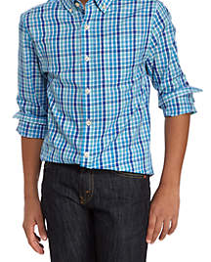
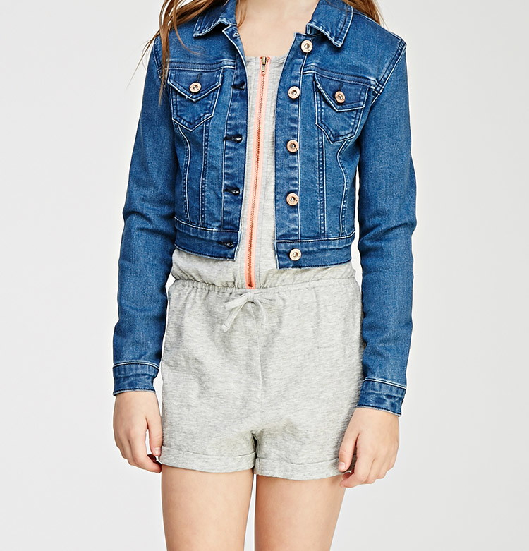
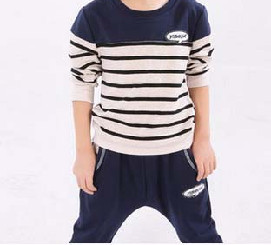
Why do you Choose the Clothes you Wear?
Notes:
Ask question and allow participants to answer.

Slide 3
OUTFIT ONE
(circle)
OUTFIT TWO
(circle)
Knit Top or Button-up shirt | Pants or shorts or skirt | Knit Top or Button-up shirt | Pants or shorts or skirt
Long Sleeve or Short Sleeve or Sleeveless | Long or short | Long Sleeve or Short Sleeve or Sleeveless | Long or short
Loose or Body fitting | Loose or Body fitting | Loose or Body fitting | Loose or Body fitting
Fabric: Solid color or Print Actual Color:________ | Fabric: Solid color or Print Actual Color:__________ | Fabric: Solid color or Print Actual Color:___________ | Fabric: Solid color or Print Actual Color:___________
Shoe type: Shoe color: | Accessories (List): | Shoe type: Shoe color: | Accessories (List):
Notes:
To get started, think about what you wear on a daily basis and describe two outfits as shown here and on your handout.
One can be what you wear to school but make the other something you wear when you are with your friends on week-ends or to a ball game, etc.
(Give participant time to complete.)

Slide 4
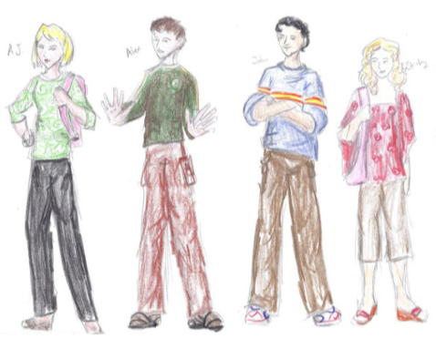
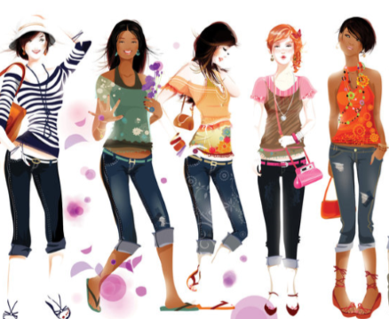
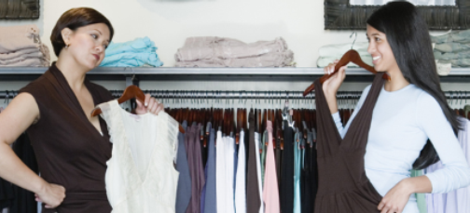
CLOTHING REFLECTS OUR VALUES CREATING OUR CLOTHING PERSONALITY
What are ‘values”?
Important and lasting beliefs or ideals shared by the members of a culture about what is good or bad and desirable or undesirable.
Important beliefs or ideals shared by the people around us; Name something that is important to you
What is prized, cherished, treasured
As we form our values we may reflect, reject, or accept a portion of these ideas.
Through experimentation, our clothing personality is developed.
Notes:
We say something about ourselves by the way we dress.
This is our own “clothing personality.”
How do we develop our “clothing/fashion personality”?
It starts with the ideas society has as to what is best and right for people to wear.
This is based on society values (read from slide explaining the term values)

Slide 5
Material Comfort
(Economics)
External Conformity
(Belonging to a peer group)
Individuality
(Being unique)
Equality of Social Status
(Wanting to belong to a different group)
Notes:
How do our values play a part in our fashion style? Consider these aspects. Which one describes how why you wear what you wear? (Give participants time to respond)

Slide 6
WHERE DO YOU WEAR YOUR CLOTHING?
I wear the majority of the clothes in my closet at:
_____School
_____Leisure Activities
_____When Enjoying my Hobbies
_____Religious Functions
_____Cultural and/or Formal (dressy) occasions
(If you have a good amount of clothes in your closet in more than one category above, check those above.)
Notes:
Now let’s look at your own personal wardrobe; Complete this on your handout; What came up on top? How do you personalize what you wear to school?

Slide 7
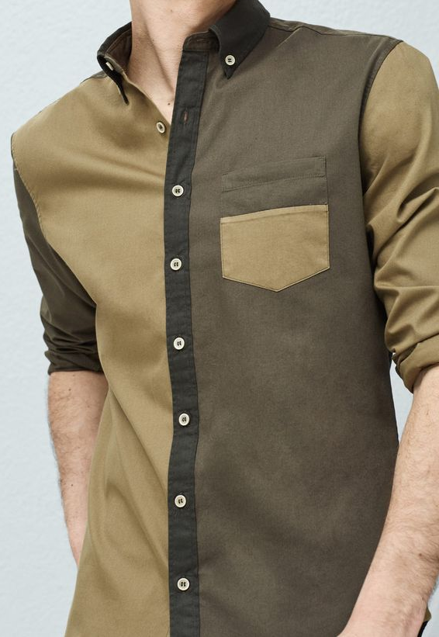
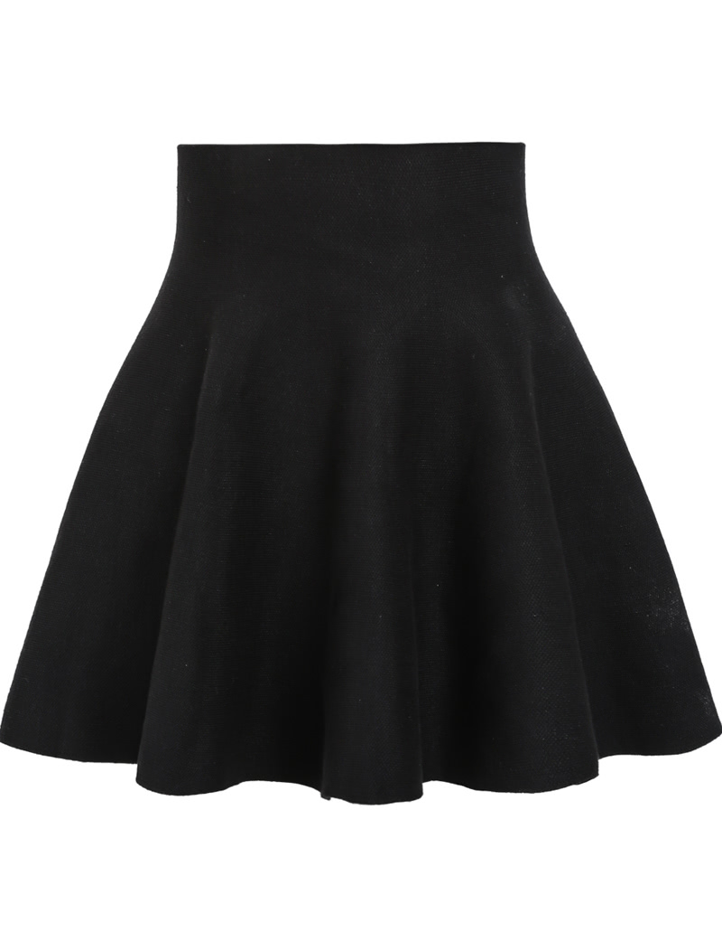
IDENTIFYING YOUR PERSONAL STYLE
Notes:
Now we are going to explore different fashion styles, where you can actually put a name to your own style

Slide 8
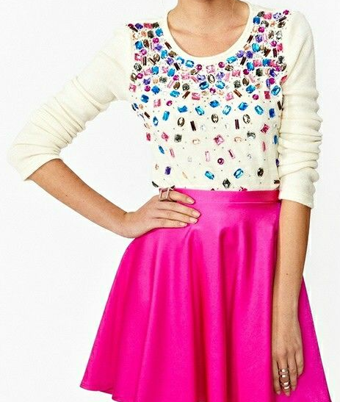
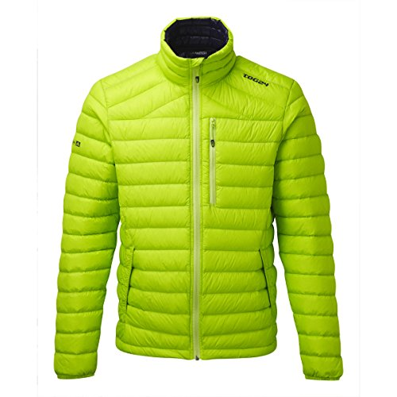
Dramatic
Bold, colorful dressing
Large and spectacular accessories
First to try a new style
Guys in this style are usually tall and thin

Slide 9
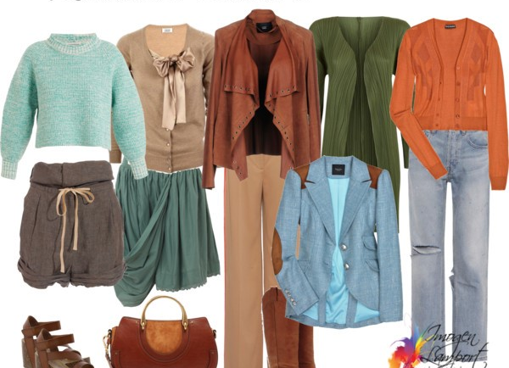
Sporty/Natural
Relaxed or outdoorsy feeling
Simple clean-cut lines
Easy care hairstyle
Lots of denim, khaki, and button-front styling
Loves animals and prefers to be outside

Slide 10
Gamine
Smaller\shorter version of sporty/natural
Pixie hairstyles and sporty/natural clothing styles.
Guys are youthful looking and have an eye for detail

Slide 11
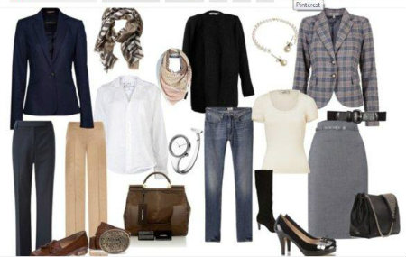
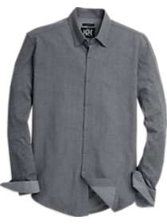
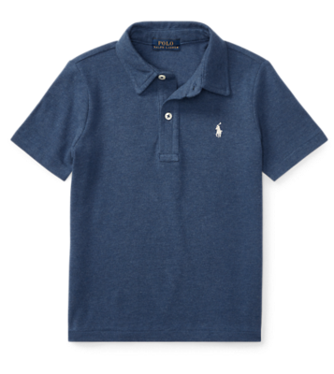
Classic
Tailored looks
Classic sweaters, pleated skirts or pants
Very neat
Everything is in place
Stylish in moderation

Slide 12
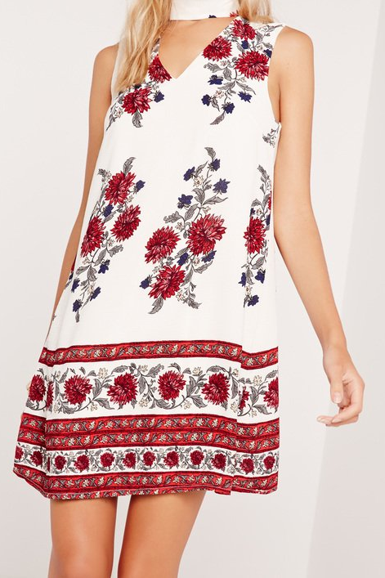
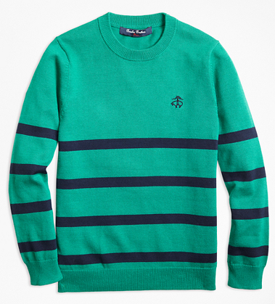
Romantic
Lots of fullness and softness
Large plaids, large prints, large details
Females like large ruffles, lace and bows
Males like baggy pants and full cut shirts & sweaters

Slide 13
Ingenue
(on-jin-u)
Soft spoken,
Likes fine detail,
Looks good in small details

Slide 14
Identify Your Personal Style
My style is:_____________________________________________________
Is there anything you would add to your outfits to make them better reflect your style? Yes No
If ‘yes’ describe here what you would add:________________________________________________
Now that you have identified your personal style, look at the descriptions of that style and/or examples given.
If you could buy an outfit for a special occasion reflecting your identified style, describe what that outfit would look like including color, fit, length, etc.
I would wear my special occasion outfit to:____________________________________
Description of outfit:
Notes:
Let’s review these styles so you can best identify your specific style. (flip through slides 8-13) Look at your sheet and let’s complete the questions together, first writing down your answers then we will share with each other. You may find that your style is a combination of two styles and that’s okay. (You may have them complete each question and then discuss the answers one at a time.)

Slide 15
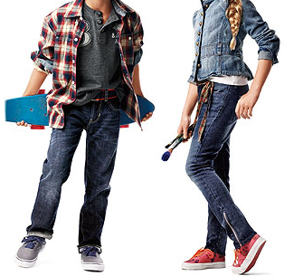
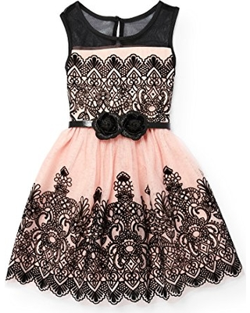
Test your Knowledge
Classic
Dramatic
Romantic
Gamine (Natural/
Sporty)
Sporty/ Natural
Ingenue
Notes:
Can you identify the styles shown here into the personality group in which it belongs?
Try it then I will show you the answer. (only click once to show the different images. Then click again and the answers will appear. Try not looking on your handout. Discuss the answers they came up with.)
Now we are going to have you create your own style and make your own fashion story based on your style.
Let’s first divide into groups according to your identified style.

Slide 16
The following slides are fashion examples for each style that can be copied and cut apart for the 4-Hers to use in creating their own fashion story or can be uploaded to computers for them to select from and create their fashion story on a computer

Slide 17
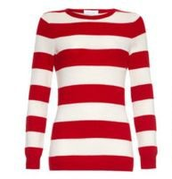
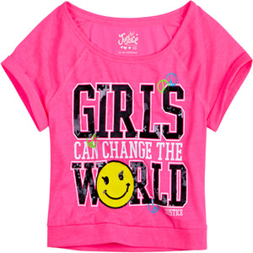
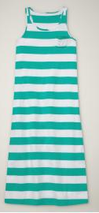
Dramatic

Slide 18
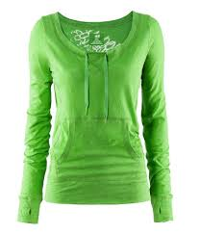
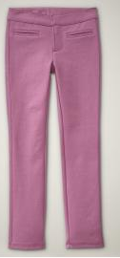
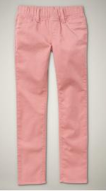
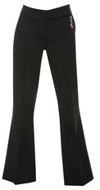
Dramatic

Slide 19
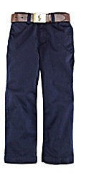
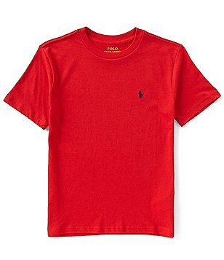
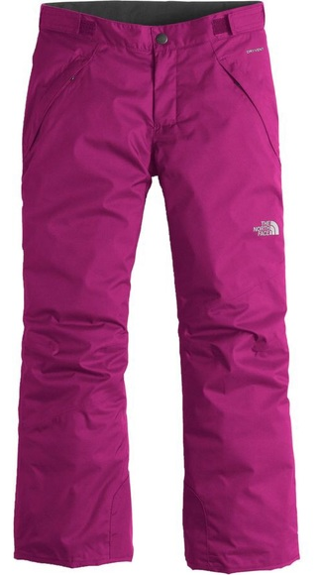
Dramatic

Slide 20
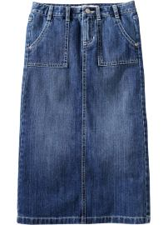
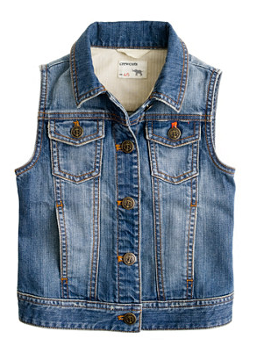
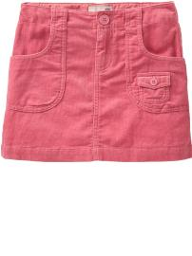
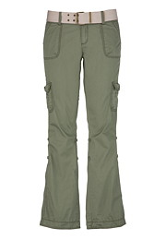
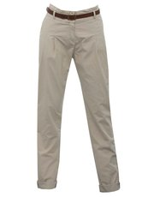
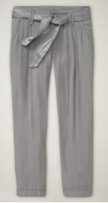
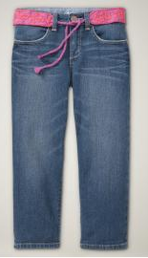
Sporty/Natural

Slide 21
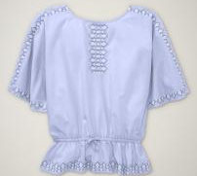
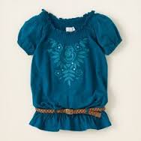
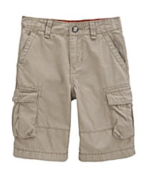
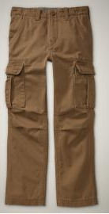
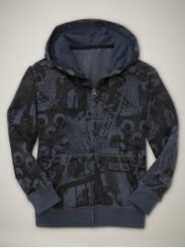
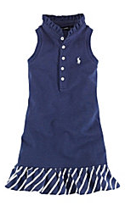
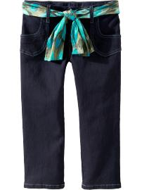
Sporty/Natural

Slide 22
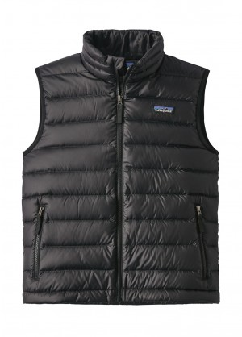
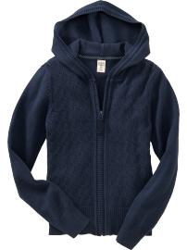
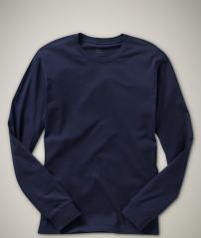
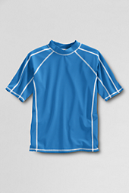
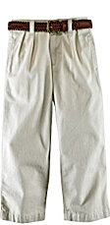
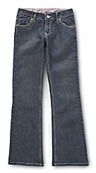
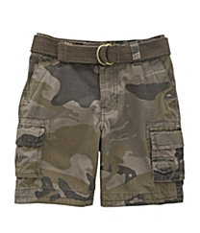
Sporty/Natural

Slide 23
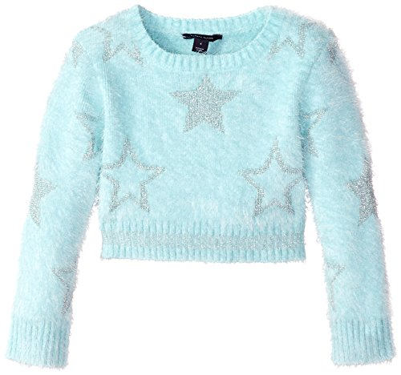
Gamine

Slide 24
Gamine

Slide 25
Classic

Slide 26
Classic

Slide 27
Romantic

Slide 28
Romantic

Slide 29
Romantic

Slide 30
Ingenue

Slide 31
Ingenue

Slide 32
Ingenue

